Slide 1
VENTILATOR BASICS + NIPPV, Capnography, Vent settings & complications
EM/CC LECTURE SERIES
KIMBERLY PISTELL, DO
LT, MC, USN
NMCP EMERGENCY MEDICINE PGY4

Slide 2
OUTLINE
Oxygenation
Ventilation
Breath types
Modes
Noninvasive
CPAP vs BiPAP
HiFLO
Ventilator terminology
Waveform Capnography
Vent Settings: Approach
Troubleshooting
Complications
Push-dose pressors
Pulse Oximetry
Resources

Slide 3
OUTLINE
There are many different ways to approach learning this topic.
I have set this lecture up to learn either from a ground-up approach or problem focused approach. Click on the an outline topic on the previous slide in presentation mode to jump to a section.

Slide 4
BACKGROUND
NIPPV and mechanical ventilation help with
Oxygenation
Ventilation (CO₂)
Muscle fatigue

Slide 5
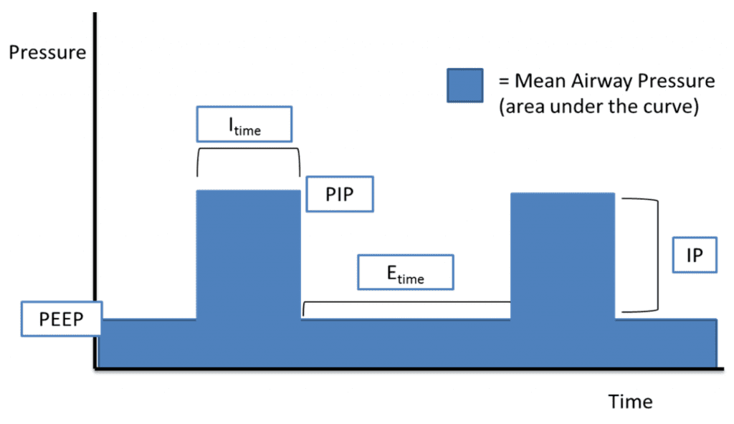
OXYGENATION
Oxygenation can be influenced by:
FiO2
Mean Airway Pressure (MAP)
1. Why increasing PEEP helps improve oxygenation- you are increasing the area under the curve
2. Can also increase I_{time}
2
1

Slide 6
VENTILATION
Ventilation refers to the removal of CO₂
Increase CO₂ removal = minute ventilation = RR and tidal volume
Minute Ventilation = RR x Vt

Slide 7
TYPES OF BREATHS
Controlled: Breaths only delivered at a rate you set-vent does ALL the work
Assisted: Patient initiated breaths-vent dose ALL of the work
Supported: Patient initiated breath-vent provides SOME of the work
Volume: A set volume is delivered at whatever pressure is required
Cons: uncomfortable/not physiologic, may require too high of pressures
Pressure: A set pressure over time provides whatever volume your lung compliance allows
Pro: more physiologic/comfortable
Cons: may not achieve adequate volumes

Slide 8
MODES
Volume Assist Control (AC): You set the volume (typically 6-8cc/kg), RR, FiO2, PEEP
Assist = if patient triggers a breath faster than your set rate, they will receive the preset volume
Pressure Assist Control (AC): You set the pressure on top of the PEEP (targeting normal Vt) RR, FiO2
Assist = if patient triggers a breath faster than your set rate, they will receive the preset pressure over the set I_{time}
Pressure Support (PS): You set a pressure-that’s it, similar to CPAP. This mode is typically used during SBT (spontaneous breathing trial). Patient initiates every breath and receives the set pressure. (~ 5 cmH₂O)

Slide 9
MODES
Synchronized Mandatory Ventilation (SIMV) + PS: Combines all 3 modes. You set RR, FiO2, PEEP
Volume/Pressure control: you set the volume/pressure which will be given at a set rate if the patient does not trigger a breath. The machine will provide an ASSISTED breath (machine still does the work) if the patient triggers a breath around the set rate. If they trigger a breath in between the set rate breaths, then they will receive a SUPPORTED breath with a preset pressure.
Pressure Regulated Volume Control (PRVC): You set V_{t}. Breaths can be controlled or assisted.
The machine calculates the patient’s lung compliance and delivers the set V_{t} at the lowest possible pressure. If compliance decreases, then more pressure is needed to achieve the set tidal volume.
SIMV/PRVC + PS: typically seen in the PICU.
You set the V_{t}, RR, FiO2, PEEP, and PS (pressure support)
The machine will deliver pressure regulated breaths at a set rate based on lung compliance to achieve a set V_{t} and will provide pressure supported breaths if triggered in between the set rate

Slide 10
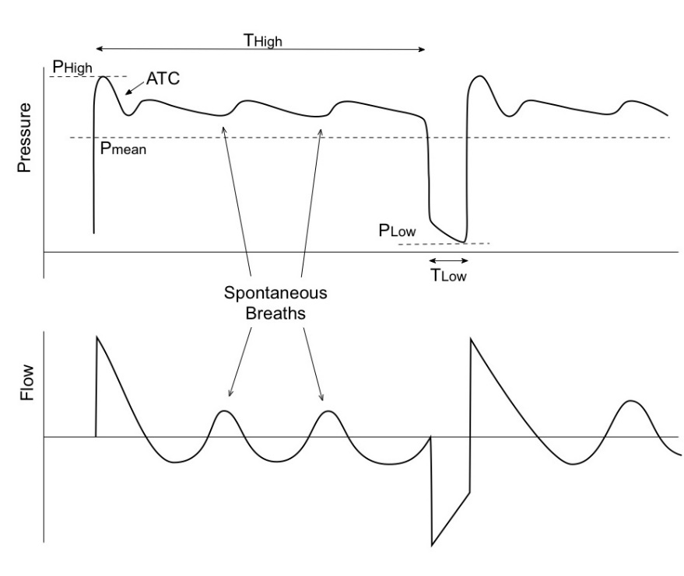
MODES
Airway Pressure Release Ventilation
“elevated CPAP” allows for alveoli recruitment and gas exchange
Open exhalation valve allows for spontaneous breathing dur T_{high}
Used typically for ARDS (esp COVID)
Initial settings:
P_{high} ~ 30, P_{low} 0, T_{high} 5-6 sec, T_{low} 0.5 sec
https://resusreview.com/2013/aprv-ventilation-mode-introduction-basic-use-management-and-advanced-tips/

Slide 11
TYPES
Noninvasive
CPAP
BiPAP
HFNC
Invasive
Intubation
Cricothyrotomy
https://emcrit.org/ibcc/support/

Slide 12
NONINVASIVE
Indications:
- Respiratory support in an awake, stable, patient able to clear secretions without active vomiting or immediate risk for cognitive decline
Prevent respiratory muscle fatigue
Diseases:
COPD/Asthma
CHF
Neuromuscular disease
Contraindications:
Multiorgan failure
Vomiting
Facial trauma
Copious secretions
Depressed mental status
Uncooperative

Slide 13
NONINVASIVE
CPAP
Increase mean airway pressure (MAP) and oxygenation
Good for hypoxemic respiratory failure
Useful when all you need is increased airway pressure (CHF)
Consistently reproduced benefits with acute cardiogenic pulmonary edema
Increase oxygenation
Increase FiO2
Increase MAP
Increase ventilation
- Increase delta
BiPAP
Driving pressure (delta) and mechanical support
Good for hypoxemic or hypercarbic respiratory failure
→ Both oxygenation & ventilation
Neuromuscular weakness
Obesity

Slide 14
NONINVASIVE: CHF
Increased mean airway pressure reduces preload and afterload
CPAP: one pressure → increases mean Airway pressure
BiPAP: expiratory pressure increases mean airway pressure
- Driving pressure (delta) = IPAP – EPAP, affects minute ventilation
Large delta not needed in CHF, high expiratory pressures are
To titrate: Increase EPAP but keep delta the same when making adjustments
EX: start 10/5, delta 5; increase to 18/13, delta 5
→ Why both CPAP or BiPAP work for CHF!!

Slide 15
NONINVASIVE: COPD/ASTHMA
BiPAP
Benefits from driving pressure (delta), especially if they are experiencing respiratory fatigue
→ Increasing delta P increases minute ventilation by increasing your V_{t}
To Titrate, increase delta P
Ex) start 10/5, delta 5; increase 15/8, delta 7

Slide 16
NONINVASIVE: NEUROMUSCULAR
Goal is to support with minute ventilation with V_{t} ,not mean airway pressure
Need Driving Pressure, aka Delta P → BiPAP
Start with low setting EPAP and IPAP, and increase your delta as needed
EX: start 10/5, delta 5; increase to 15/5, delta 10

Slide 17
NONINVASIVE: HiFlo
HFNC: warmed, humidified air at rate up to ~ 60 L/min
Benefits:
Some PEEP
Up to 100% FiO2
CO2 washout reduces anatomic dead space → improves ventilation
Better tolerated than BiPAP

Slide 18
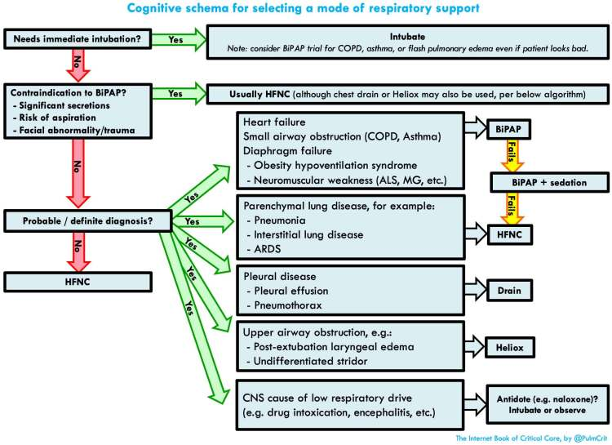
NONINVASIVE: ALGORITHM

Slide 19
Ventilator Settings

Slide 20
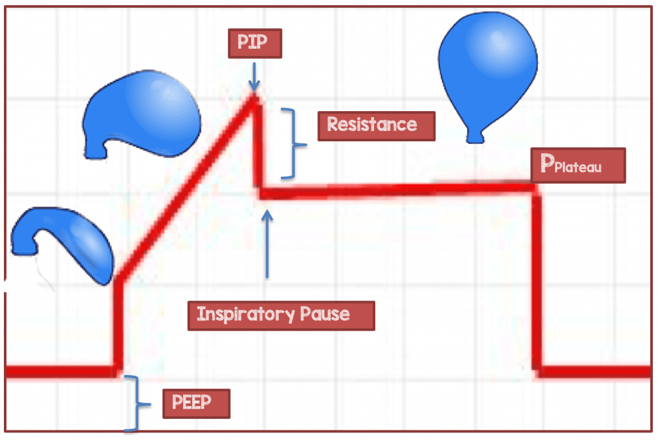
VENTILATOR: DEFINITIONS
Control breaths: set interval breaths
Assisted breaths: patient-triggered, machine-delivers pre-set breath
Supported breaths: patient-triggered, machine-delivers supported breath
Peak Inspiratory Pressure (PIP): max pressure needed during inspiration to overcome resistance pressure (ET tube and large proximal airways) and elastic pressure of lungs (small airways and alveoli)
Plateau Pressure: pressure needed to overcome elastic forces
High P_{plat} = compliance issues
Obtained with end-inspiratory hold
https://rebelem.com/simplifying-mechanical-ventilation-part/

Slide 21
VENTILATOR: DEFINITIONS
Increased PIP
Increased PIP
PIP
PIP- P_{plat} increased
PIP- P_{plat} same
Pressure
P_{plat}
P_{plat} increased
P_{plat} same
Time
Baseline
Inc resistance
Dec compliance
High PIP and P_{plat} = lung disease
High PIP, normal P_{plat} = inc airway resistance
https://rebelem.com/simplifying-mechanical-ventilation-part/

Slide 22
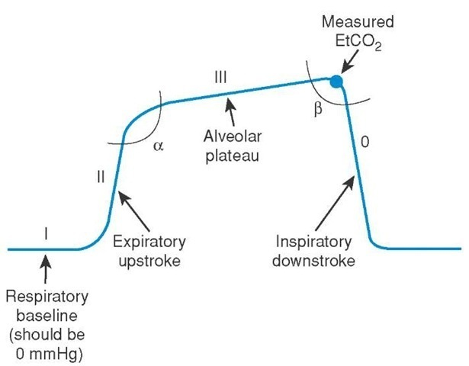
VENTILATOR: CAPNOGRAPHY
Always use capnography
Learn how to analyze
Shape
Height
Frequency
Baseline
Rhythm
http://www.emdocs.net/interpreting-waveform-capnography-pearls-and-pitfalls/

Slide 23
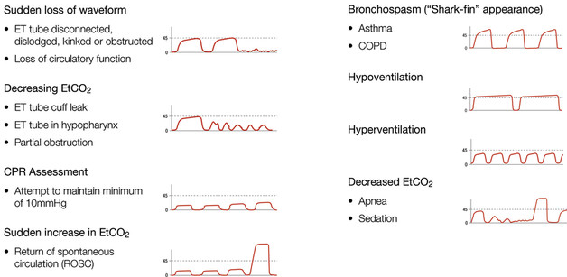
VENTILATOR: CAPNOGRAPHY
http://www.emdocs.net/interpreting-waveform-capnography-pearls-and-pitfalls/

Slide 24
VENTILATOR: APPROACH
Lung protective = oxygenation issue
Obstructive disease = ventilation issue
Post-Intubation
Assess blood gas
Check vent pressures
Wean FiO2 down to < 60%

Slide 25
VENTILATOR: LUNG PROTECIVE
ARDSNet 1994: study:1 of few trials to show mortality benefit with low-tidal-volume ventilation
ARDS: an inflammatory lung condition involving both lungs that may complicate severe pneumonia, trauma, sepsis, aspiration of gastric contents, and many other conditions
The injured lung should be managed gently with small breaths and low pressures from the ventilator.
Conservative use of intravenous fluids combined with removal of excess fluids with diuretics
http://www.ardsnet.org/

Slide 26
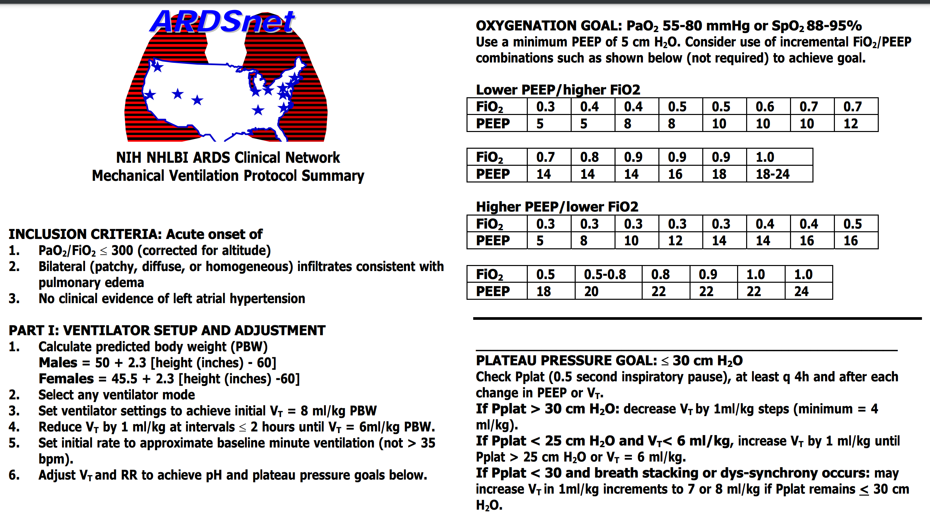
VENTILATOR: LUNG PROTECIVE

Slide 27
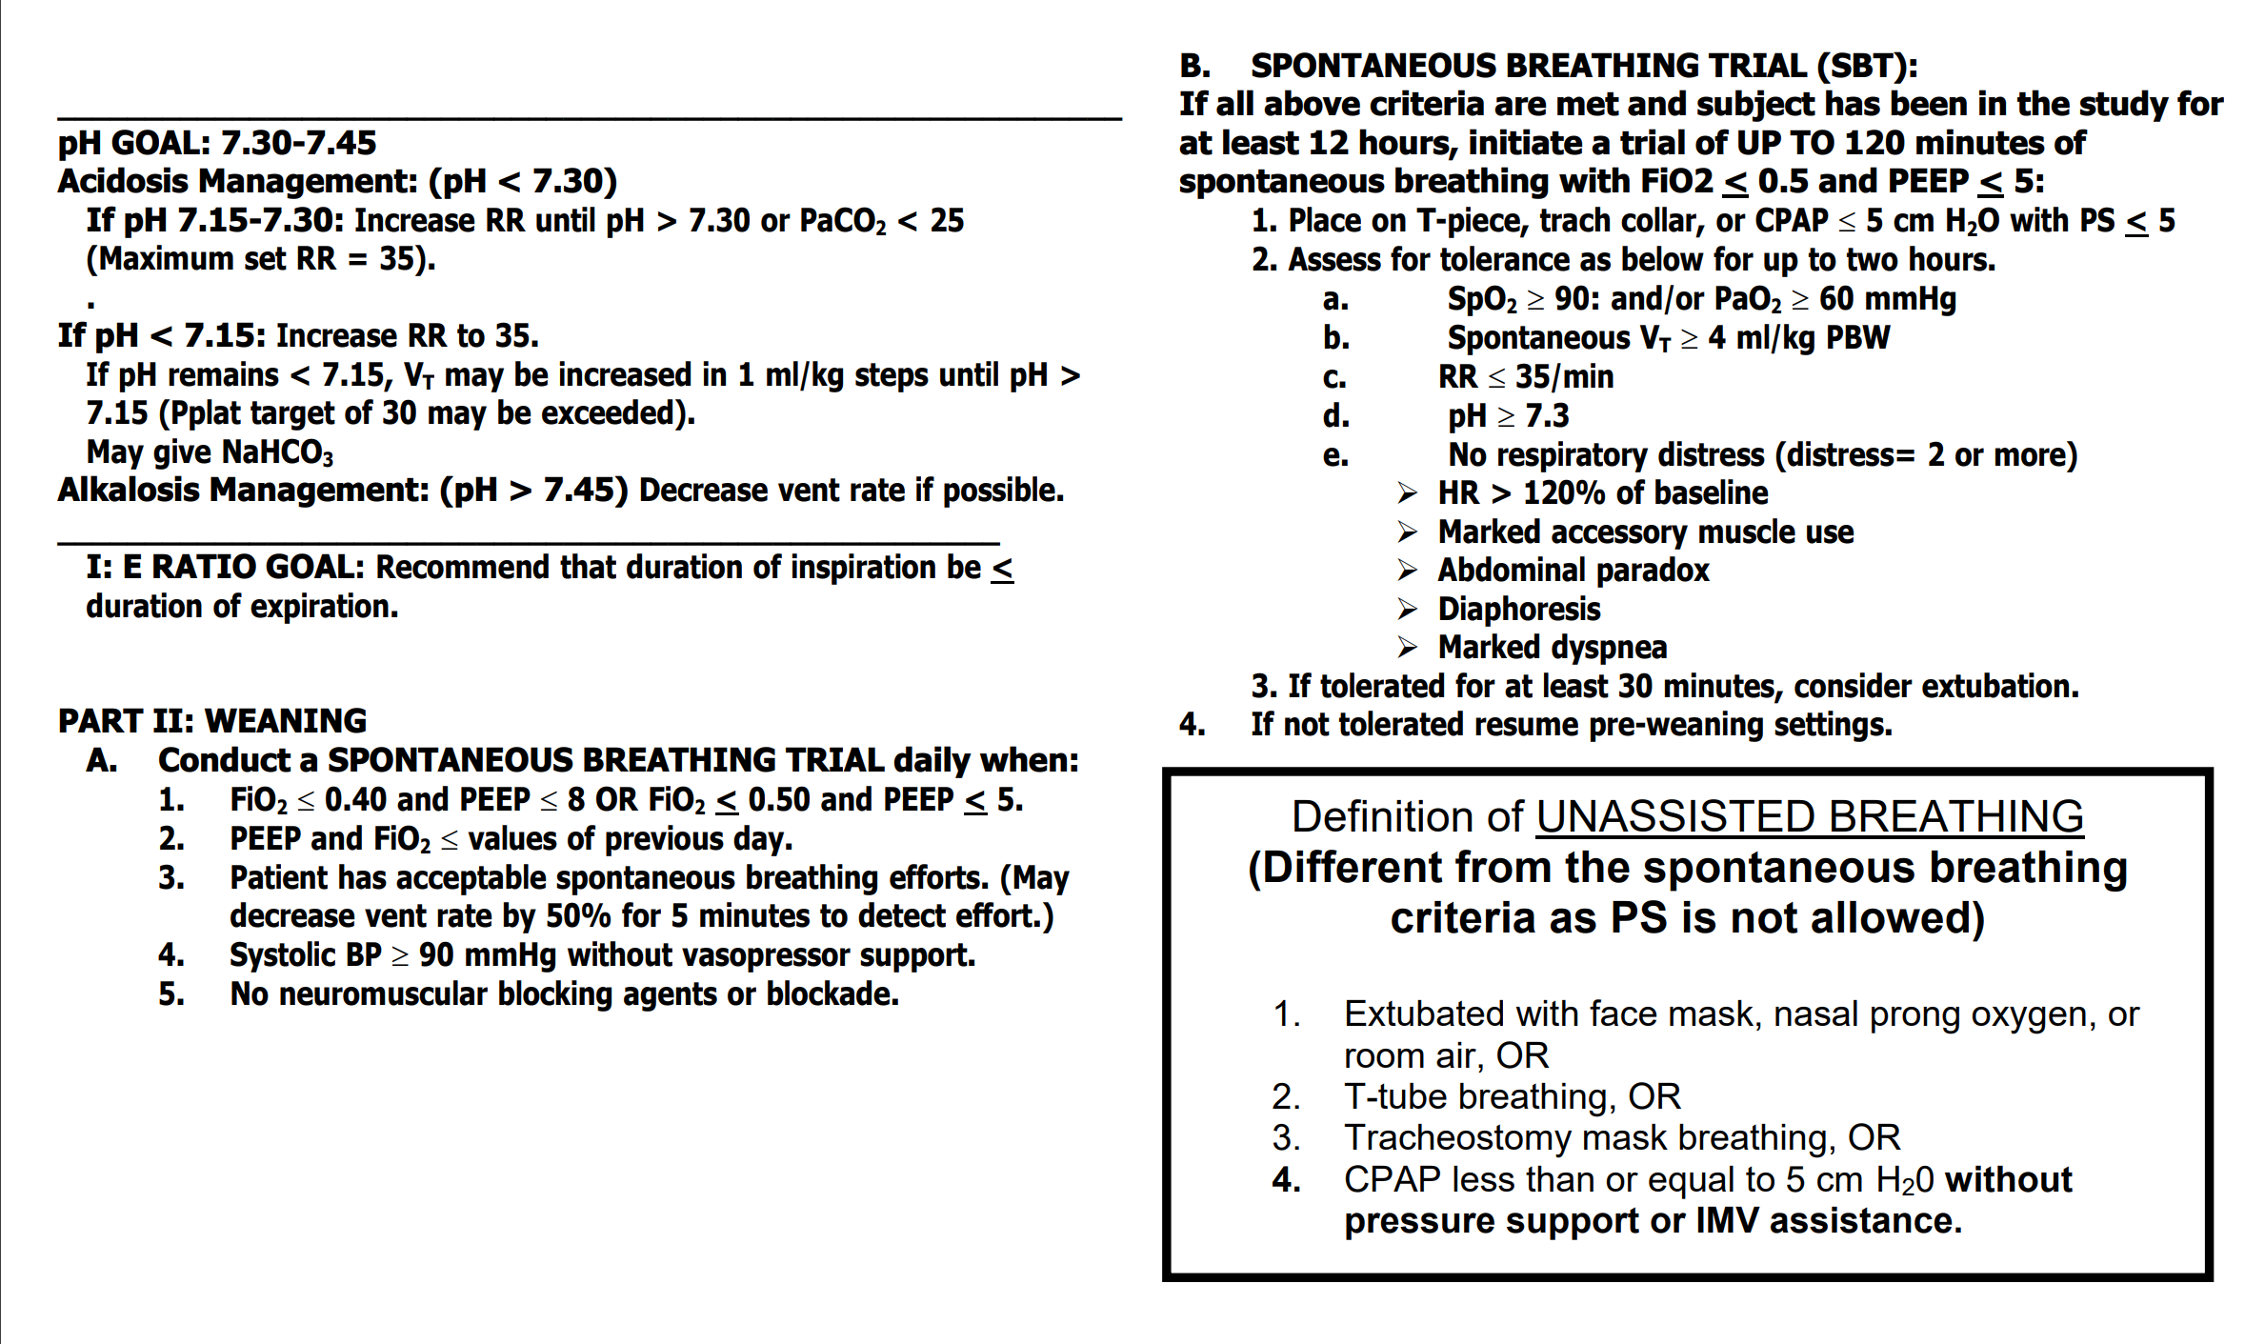
VENTILATOR: LUNG PROTECIVE
http://www.ardsnet.org/

Slide 28
VENTILATOR: LUNG INJURY
Volume Assist/Control
- 5 settings:
Tidal volume: start with 8 mL/kg PBW (alveolar protection)
RR: initial 16 bpm, adjust to achieve PaCO₂ goal
Increase rates with severe acidosis (DKA, ASA) see next slide
PEEP: initial 5 cmH₂O, increase for improved oxygenation
FiO2: initial 100%, titrate down
Flow: initial 60 L/min (patient comfort)
Check blood gas 20-30 minutes after

Slide 29
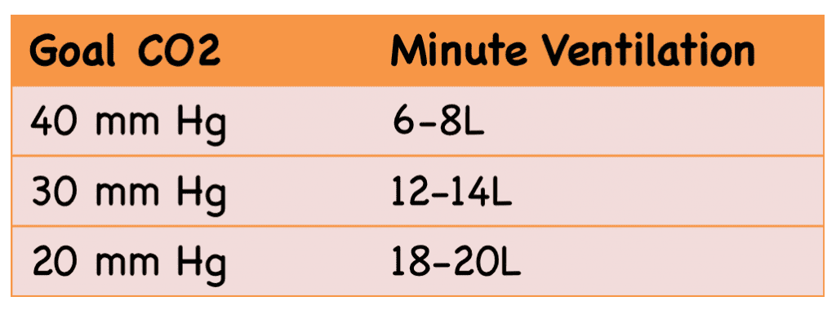
VENTILATOR: METABOLIC ACIDOSIS
1. Calculate goal PaCO₂ using Winter’s formula
Goal C0₂ = 1.5 X HCO₃+ 8 (+/- 2)
2. Use the table to get a rough estimate for minute ventilation
3. Check blood gas after 20-30 minutes
Inadequate compensation
→ cardiac arrest!!!
https://rebelem.com/simplifying-mechanical-ventilation-part-3-severe-metabolic-acidosis/

Slide 30
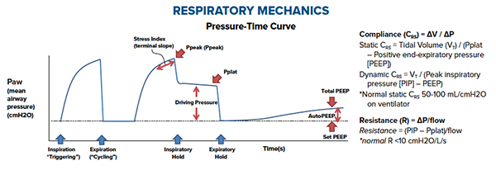
VENTILATOR:CHECK PRESSURES
https://www.emra.org/emresident/article/demystifying_ventilator_alarms/
Peak Pressure: alveolar pressure + large airway + ventilator equipment
Plateau Pressure: pressure in alveoli, during inspiratory hold
Goal < 30 cm
If elevated, decrease tidal volume (= alveolar protection), not PEEP

Slide 31
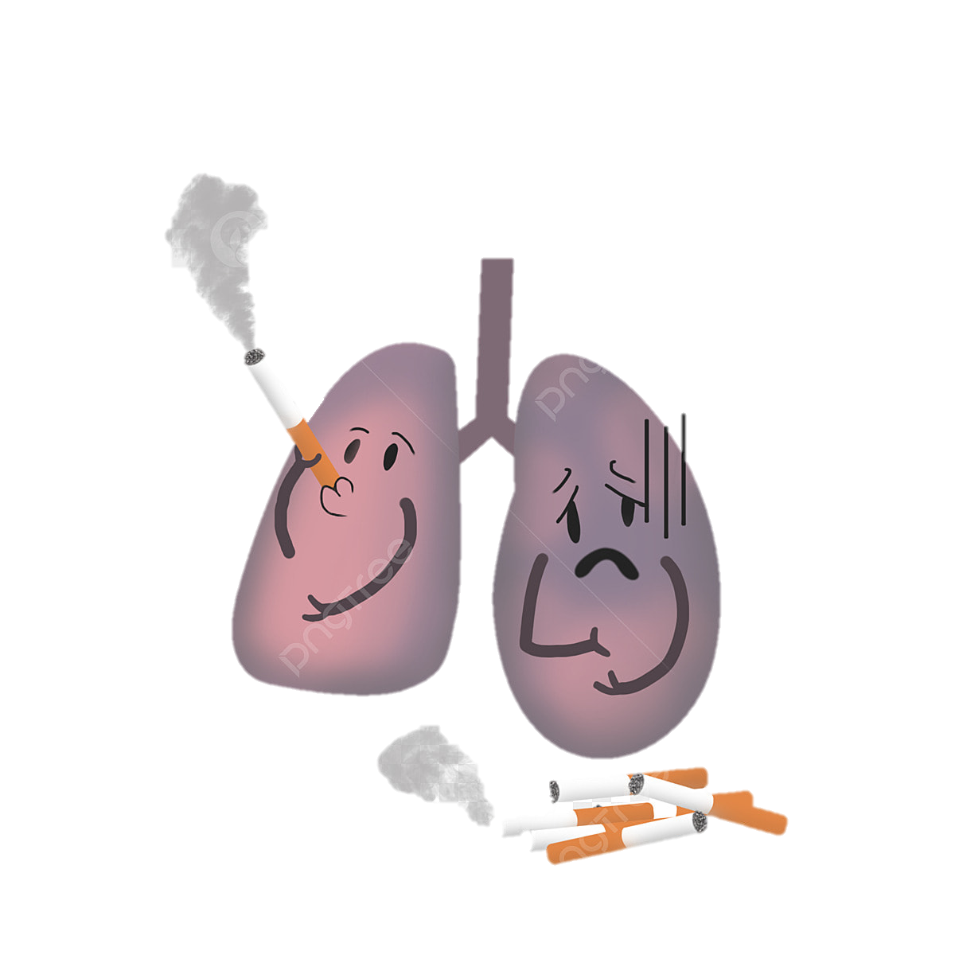
VENTILATOR: OBSTRUCTIVE DISEASE
Volumes Assist/Control
5 Settings
Tidal volume: same 6 - 8 mL/kg PBW
RR: initial 8-10 bpm, lower to allow longer time expiration
Permissible hypercapnia
PEEP: low < 5, (oxygenation is not the issue)
FiO2: low 40%, (oxygenation is not the issue)
Flow: initial 60-80 mL/min, may need to adjust I:E ratio 1:4 or 1:5

Slide 32
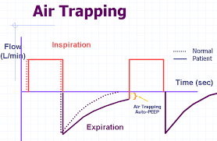
VENTILATOR:CHECK PRESSURES
https://www.emra.org/emresident/article/demystifying_ventilator_alarms/
Peak Pressure: will be elevated due to obstructive disease; alveolar pressure + large airway + ventilator equipment
- Increase vent alarm settings for Peak Pressure
Plateau Pressure: should remain < 30; pressure in alveoli, during inspiratory hold
- If elevated- decrease respiratory rate, increase inspiratory flow rate, decrease I:E

Slide 33
VENTILATOR: VOLUME ASSIST/CONTROL
Disadvantages:
Cannot match natural inspiratory flow pattern (constant flow rate)
Decreased patient comfort → add sedation
Less control over peak inspiratory pressures

Slide 34
VENTILATOR: PRESSURE ASSIST/CONTROL
Pressure Assist/Control
- Constant pressure with variable decelerating inspiratory flow
Advantage: patient comfort, greater control over pressure
Disadvantage: less control over minute ventilation (Tv x RR)

Slide 35
VENTILATOR: TROUBLESHOOTING
Persistent hypoxemia
Intubate with 100% Fi02, then quickly wean to < 60%
Consider interventions if unable to titrate < 60% after a few hours
Treat/identify underlying cause
Increase PEEP
Paralysis
Prone positioning
ECMO

Slide 36
VENTILATOR: PERSISTENT HYPOXEMIA

Slide 37
VENTILATOR: TROUBLESHOOTING
DOPESS
Dislodgement: too shallow/deep
Check tube depth (3 X tube size)
Caution with increasing depth if too shallow. Recommend visualizing with laryngoscope.
Obstruction: mucus, biting, kinked tube, bronchospasm
Pass a suction catheter through?
Increase paralysis if biting
Pneumothorax:
Visualize lung sliding on ultrasound?
Equipment failure: leak
Check entire circuit-cuff to vent
Stacking (breath): check flow curves
Does the flow curve reach 0?
No → Disconnect vent
Synchrony: erratic breathing
Increase sedation/paralysis

Slide 38
VENTILATOR: COMPLICATIONS
Ventilator Induced Lung Injury
Barotrauma
Atelectotrauma
O₂ toxicity
Hemodynamics
Decreased preload
Increased RV afterload
Decreased LV afterload
Acidosis
HOp Killers
Hypotension, hypOxemia, pH
Preoxygenate
&
Resuscitate before intubate!!!

Slide 39
VENTILATOR: HYPOTENSION
Pre-intubation hypotension < 90 risk factor for cardiac arrest
IVF bolus
Pressors/”Boom Stick”
Caution in acute RV failure
Pulmonary vascular resistance
Systemic vascular resistance
Vasoactive meds | PVR/SVR | Right HF
Norepinephrine | +/- | OK
Epinephrine |  | Good
Vasopressin |  | Good
Phenylephrine |  | Bad
**Works better than other pressors at low pH**
Increases pulmonary vascular resistance

Slide 40
VENTILATOR: PUSH-DOSE PRESSORS
1 mL + 9 mL → 10 mcg/mL
1 mL + 100 mL → 100 mcg/mL

Slide 41
VENTILATOR: HYPOTENSION
RSI meds
Induction agents can drop BP by decreasing vascular tone and reducing venous return as well as sympathetic tone with some (benzos, propofol)
Preferred: ROCKETamine - low-dose ketamine and high dose rocuronium
Ketamine- sympathetic surge, 0.5-1mg/kg
Rocuronium 1-1.6 mg/kg

Slide 42
VENTILATOR: ACIDOSIS
Mechanism:
Apnea during intubation increases CO₂ → worsening acidemia
Bicarb (HCO₃) converts to CO₂ and H₂O → increased CO₂ levels → worsening acidemia
Recommendations
Try to avoid intubation in the severe acidotic patient
Bicarb therapy- controversial. No studies have shown proven benefit when given pre-intubation for the severely acidotic.

Slide 43
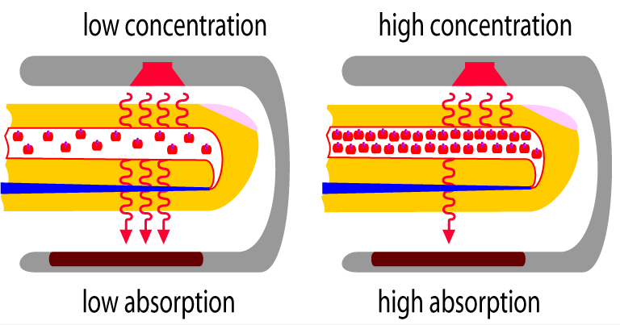
PULSE OXIMETRY
Pulse oximetry is based on the principle that O2Hb and HHb (deoxygenated Hb) absorb red and near-infrared (IR) light differentially.
Pulse oximeters emit 2 wavelengths: red at 660 nm and near-IR at 940 nm.
The relative amount of red and IR light absorbed are used by the pulse oximeter to ultimately determine the proportion of Hb bound to oxygen using a calibration curve factor.

Slide 44
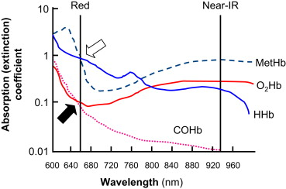
PULSE OXIMETRY
A microprocessor uses a ratio (calculated over a series of pulses) to determine the SpO2 based on a calibration curve that was generated empirically by measuring healthy volunteers whose saturations were altered from 100% to approximately 70%
O2Hb and COHb absorb red light similarly. COHb absorbs very little near-IR.
→ Standard pulse oximeters that only emit red and near-IR light cannot differentiate between O2Hb and COHb.

Slide 45
PULSE OXIMETRY
MetHb absorbs both red and IR light equally well.
→ High MetHb levels result in an SpO2 of 80–85%.

Slide 46
VENTILATOR RESOURCES
REBEL EM: https://rebelem.com/simplifying-mechanical-ventilation-part/
EMCrit Push-dose pressors: https://emcrit.org/emcrit/bolus-dose-pressors/
Emdocs Capnography: http://www.emdocs.net/interpreting-waveform-capnography-pearls-and-pitfalls/
Resus Review APRV: https://resusreview.com/2013/aprv-ventilation-mode-introduction-basic-use-management-and-advanced-tips/
ARDSnet: http://www.ardsnet.org/

