Slide 1
Transplant Medicine in the Emergency Department and Beyond…
LT Monaco

Slide 2
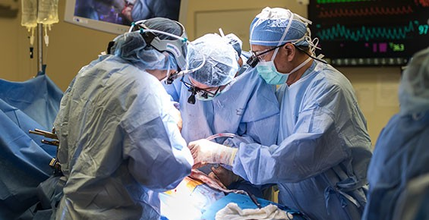
Outline
Basics
Anatomical problems
Infection
Rejection
Drug Toxicity
Organ Specific
References

Slide 3
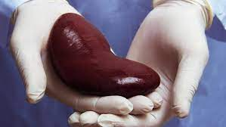
Basics
1 Year survival rate
Solid organ > 80%
Transplanted organs lack innervation
Subtle signs and symptoms can be harbingers of severe disease
Complications
Anatomy
Infection
Rejection
Drug Toxicity
Notes:
Transplant image: https://columbiasurgery.org/news/2019/07/10/overhaul-treatment-kidney-disease-long-overdue-kidney-transplant-surgeon-explains

Slide 4
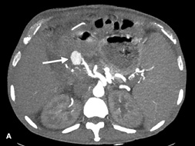
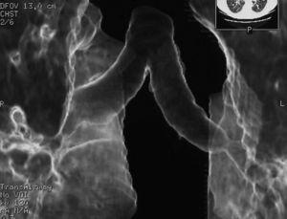
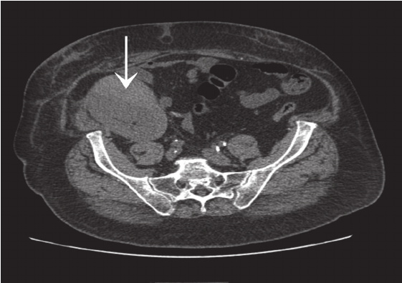
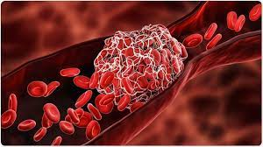
Anatomical Problems
Non-Vascular (Bile ducts, bronchi, ureters)
Vascular
Surgery
Arterial and Venous Thrombosis
Pseudoaneurysms and Rupture
Arterial Stenosis
Leaks
Obstructions
Hematomas/swelling
Notes:
(in liver xplant hepatic artery is the sole source of blood flow)
Hepatic us often performed immediately after transplant to ensure good hepatic artery flow
Obstructions= due to scar tissue, stent migration, stone development
Prolonged leaks can lead to abscess
Images:
Random pic of a clot
https://thrombosis.org/patients/what-is-thrombosis/
Hepatic artery stenosis
https://www.cureus.com/articles/29558-liver-transplant-complications-radiologist-cant-miss
Hepatic artery pseudoaneurysm
https://www.heraldopenaccess.us/openaccess/hepatic-artery-pseudoaneurysm-after-hepatic-transplant-endovascular-treatment-with-graft-stenting
Figure 1: Antegrade nephrostogram post RT showing urine leak A- Arrow shows site of urine leak B- Arrow showing large urinoma
https://symbiosisonlinepublishing.com/urology-nephrology/urology-nephrology41.php
Figure 2. Multisection CT with 3D reconstruction showing a stenosis distal to right bronchial suture in double-lung transplantation.
https://www.journalpulmonology.org/pt-postoperative-surgical-complications-after-lung-articulo-X0873215915856142
Plain CT scan showing subcapsular hematoma over anteromedial surface of transplanted kidney (arrow).
https://www.researchgate.net/figure/Plain-CT-scan-showing-subcapsular-hematoma-over-anteromedial-surface-of-transplanted_fig1_275216694

Slide 5
Bonus question #1
A 57 year old female with a history of renal failure now 43 days status post right renal transplant presents to the emergency department with fever, generalized weakness, cough, and diarrhea. She has been taking tacrolimus, mycophenolate, and prednisone as prescribed. Her vital signs are notable for a hr of 101, temperature of 101.1 F. Her labs show a creatinine that has elevated to 1.3 from a prior baseline of 1.0. Based on her presentation which infection is most likely?
Staphylococcus Aureus
Cytomegalovirus
Streptococcus Pneumoniae
Pseudomonas Aeruginosa
Notes:
Typically CMV occurs median 40 days after xplant
In the 1-6month range
CMV Can produce disease in a host of systems

Slide 6
Infection
Lifelong immunosuppression is generally required
Impaired Immune response → minor complaints can signify severe disease
Aggressive ED management → increased patient survival and graft function
Notes:
Pts should not be given live viral antigen vaccines, neither should family members do to risk of transmission
Is the 1# cause of mortality after transplant
Primary sources of infection= pretransplantation, community acquired, transmission from organ donor, nosocomial

Slide 7
Likely Infections Status post transplant
< 1 month
Often related to transplant procedures
Typical hospital acquired infections
1-6 months
Immunomodulating viruses (CMV, Hep B+C, BK polyomavirus, HHSV6, EBV)
Opportunistic Infections (Pneumocystis, listeria, fungal species)
>6 months
Healthy w/ functioning graft, slight increase in normal infection risk
Chronic viral disease, susceptible to various viral diseases
Chronic rejection, on high doses of immunosuppression
Notes:
First month= usually related to transplant procedures, stents, catheters, intubation. Hospital acquired pathogens are prominant
CMV in particular is a bad guy, can cause disease in multiple systems especially pneumonitis, and hepatic dysfunction and acute cardiac dysfunction and atherosclerosis, and glomerulopathy
Can be primary or due to reactivation
Typically occurs median 40 days after xplant
Cmv infection risk improving bc aggressive bronchoscopy leads to earlier dx and tx of cmv with ganciclovir and reduces cmv specific immunoglobulin
Active cmv infection can trigger or exacerbate organ rejection
EBV similar to CMV and contributes to immunosuppression and can cause mono like syndrome
EBV is implicated in B cell lymphoproliferative syndrome
6 months
- With healthy functioning graft at over 6 months only slight increase in normal community acquireds like Flu, UTI, pna
Varicella infections can lead to rapid dissemination with pna, pancreatitis, hepatitis, encephalitis, DIC. Those who are varicella-zoster negative will need high doses of varicella zoster immune globulin after any exposure, this can be life saving
The pts over 6 month with chronic rejection on high dose immunosuppression are at some of the highest risk for the life threat infections like candida, crypto, coccidioides, blastomuces, histo, listeria, nocardia, parasites
Fungal infections distinct to geographic areas, typically manifest as subacute respiratory complaints associated with fever and focal, disseminated or miliary infiltrates on cxr
Diverticulitis is the principal GI infection in transplant pts with chronic rejection often lacking peritoneal signs because inflammation is suppressed

Slide 8
Rejection
Immune response to allograft waxes and wanes
Ongoing surveillance is required
Infection vs Rejection difficult in ED
Typically requires cultures and biopsies
Notes:
3 phases: hyperacute, acute, chronic

Slide 9
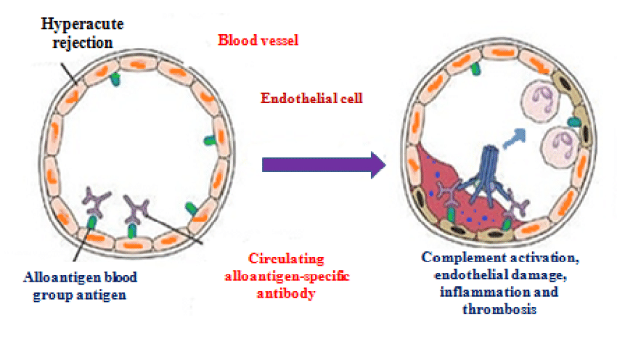
Hyperacute Rejection
Rare with matched donor
Timing: immediate perioperative period
Notes:
Image
https://www.researchgate.net/figure/Showing-Mechanism-of-Hyperacute-Graft-Rejection_fig2_331196902

Slide 10
Acute Rejection
Timing: first months or any time if immunosuppressants stopped
Clinical: constitutional symptoms & signs of transplant organ insufficiency
Diagnosis: Labs, allograft biopsy
Treatment: Adjustment of immunosuppressants
Notes:
Acute rejection can occur from first week to 6 months after transplant as cellular rejection or acute humoral rejection..I guess at a basic level the two ways it occurs are either cellular via T cell mediated or a humoral B cell response…possibly less than 15% of transplant pts these days
Acute celluler
Immuno response in host/recipients lymphoid tissue due to lymphocytes stimulated against donor antigens. The donors dendritic cells enter the recipients circulation → act as antigen presenting cells
Acute humoral
Also acute vascular rejection
Severe organ injury medicated by antibodies and complement
Antibodies can be pre-exisint or represent anti-donor antibodies shortly after grafting
https://www.cureus.com/articles/123080-classic-and-current-opinions-in-human-organ-and-tissue-transplantation
Acute Cellular Rejection
This is an immunological response in the host's/recipient's lymphoid tissues due to lymphocytes stimulated against donor antigens. The donor's dendritic cells enter the recipient's systemic circulation to function as antigen-presenting cells (APCs) [50,61]. It is common in renal grafts. Acute cellular rejection detection involves biopsy, B-lymphocyte antigen CD20 staining in cases not responding to treatment, negative kidney C4d staining, positive activating lymphocyte markers test, and proteomic study [62]. The first rejection instance is treated with pulse intravenous steroids and may be repeated in cases of recurring or refractory rejections. The second line of treatment (Thymoglobulin and a murine monoclonal antibody, OKT3) may be used for deteriorating grafts. The prognosis depends on the number of rejection episodes, potent drugs, time of rejection from transplantation, and response to treatment [62].
Acute Humoral Rejection
This is also called acute vascular rejection. It is a severe organ transplant injury mediated by antibodies and complement. The antibodies may be pre-existing or represent anti-donor antibodies developing shortly after grafting [63,64]. Willicombe et al. [65] demonstrated that even low donor-specific antibodies titer not detectable with flow cytometry or complement-dependent cytotoxic cross-matches is linked to lower-ranking renal allograft outcomes. Such patients will likely need augmented immunosuppression. Loupy et al. [66] posited a significant swing in the first-year post-graft in the C4d Banff scores, thus proving the humoral process's changing and painless nature of C4d is not a sufficiently sensitive marker. Still, inflammations in the microvessels and spotting of donor-specific antibodies are better markers of humoral rejection.
Chronic Graft Rejection (CGR)
This is also called chronic transplant rejection (CTR). The allograft function is lost several months to years after grafting. Although the graft may still be in place, graft function loss is due to persisting immune system attacks on the allo-MHC. CGR is mediated by humoral as well as cellular immunity. Although immunosuppressants and tissue-typing methods are helpful in the first-year post-graft, CGR is almost always not preventable. It appears to be fibrotic scarring in the grafted organs, although the specific histopathology image depends on the grafted organ [67].

Slide 11
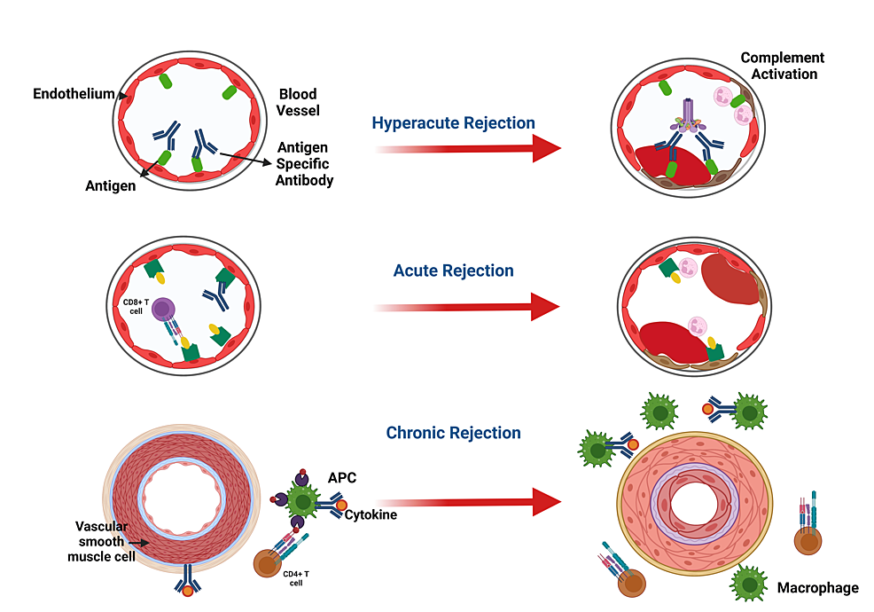

Slide 12
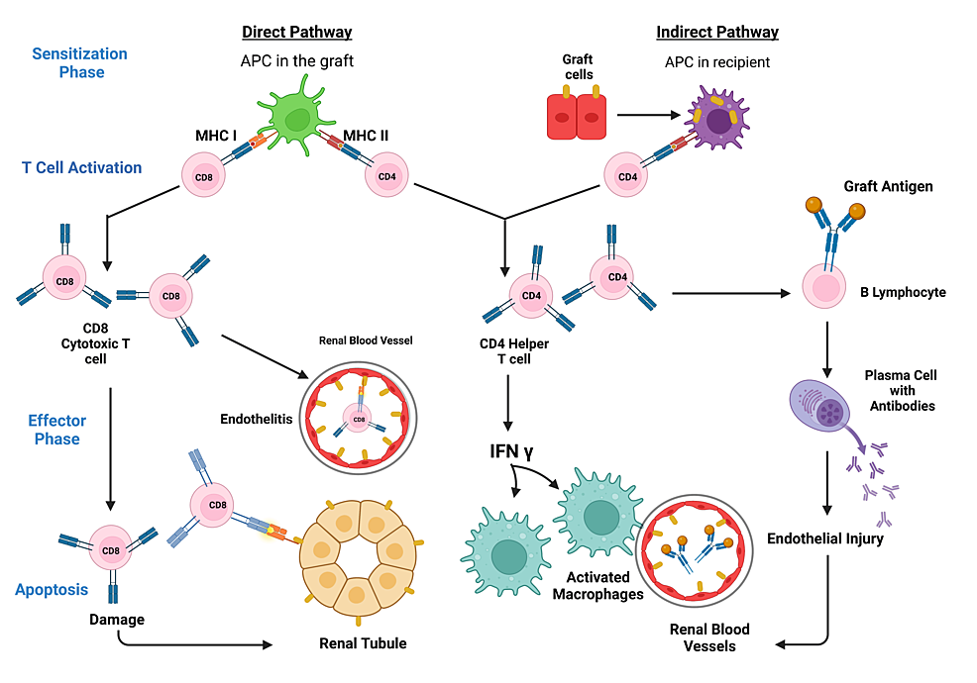

Slide 13
Chronic Rejection
Timing: Years
Clinical: Gradual failure of transplanted organ
Notes:
Chronic Graft Rejection (CGR)
This is also called chronic transplant rejection (CTR). The allograft function is lost several months to years after grafting. Although the graft may still be in place, graft function loss is due to persisting immune system attacks on the allo-MHC. CGR is mediated by humoral as well as cellular immunity. Although immunosuppressants and tissue-typing methods are helpful in the first-year post-graft, CGR is almost always not preventable. It appears to be fibrotic scarring in the grafted organs, although the specific histopathology image depends on the grafted organ [67].

Slide 14
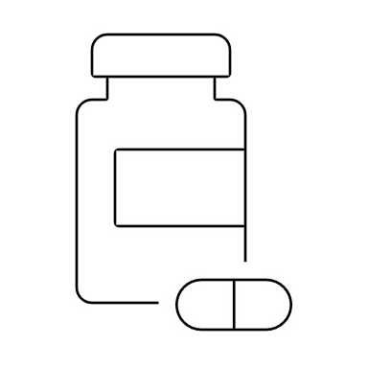
Immunosuppression Drug Toxicity
Immunosuppressive therapies are carefully balanced
Regimens are center specific
Typically includes: Calcineurin Inhibitor, Anti-metabolite, steroid
Specific drugs and their interactions requires careful consideration
Discuss with transplant team, pharmacy
Notes:
Calcineurin inhibitors includes tacrolimus and cyclophosphamide
Anti-metabolites includes mycophenolate and azathioprine
Steroids
Cyclosporine
MOA: inhibits cellular and humoral immunity. Binds to cyclophilins → blocks cytokine transcription → inhibits lymphocytes → immunosuppression of helped induced T cells
Toxicities
Dose related nephrotoxicity via renal tubular damage and renal artery vasospasm (which can lead to systemic htn)
Hyperuricemia + gout
P450 inhibitors lead to elevated levels and vice versa
Tacrolimus
MOA: macrolide compound binds to lymphocyte proteins → inhibits cytokine synthesis
Favorable side effect profile, used as primary or rescue therapy for allograft rejection
Toxicities
Nephrotoxicity
Neurotoxicity
See also: hyperglycemia with steroids, diarrhea, dyspepsia…
Azathioprine
MOA: An antimetabolite derivative of 6-mercaptopurine it inhibits deoxyribonucleic acid and ribonucleic acid synthesis → lymphocyte suppression
Generally used with other agents, isn’t being used as much because of the calcineurin class
Toxicities: bone marrow toxin, hepatic dysfunction
Mycophenolate Mofetil (MMF)
MOA: selective inhibition of lymphocyte proliferation
Reduces incidence of acute rejection but with no sig changes in long term survival or transplant recipients or their allografts
Side effects: relatively favorable can cause GI side effects and hematologic tox (leukopenia and thrombocytopenia)
Corticosteroids
MOA: suppress immune system specifically T lymphocytes
Long term use side effects: Osteoporosis, cataracts, GI bleeding, glucose intolerance, skeletal myopathies
Acute use: glucose and electrolyte abnormalities

Slide 15
Common Agents
Calcineurin Inhibitors
Cyclosporine
Tacrolimus
Antimetabolites
Azathioprine
Mycophenolate Mofetil

Slide 16
Definitions
Operational tolerance- long term acceptance of a transplanted organ without definite immunosuppression. Allogenic bone marrow transplant from the solid organ donor could facilitate operational tolerance
Accommodation- acquired resistance of an organ to immune-mediated damage
Imrpovement in long term transplantation outcomes may depend on new agents with novel mechanisms of action devoid of toxicities

Slide 17
Calcineurin inhibitors
Cyclosporine
MOA: inhibits cellular and humoral immunity. Binds to cyclophilins → blocks cytokine transcription + production → inhibits lymphocyte signal production→ inhibits lymphocyte signal transduction → immunosuppression of helped induced T cells (helper T cells enhance antibody recognition and production by B cells)
Toxicities
Dose related nephrotoxicity via renal tubular damage and renal artery vasospasm (which can lead to systemic htn)
Hyperuricemia + gout
P450 inhibitors lead to elevated levels and vice versa
Tacrolimus
MOA: macrolide compound binds to lymphocyte proteins → inhibits cytokine synthesis
Favorable side effect profile, used as primary or rescue therapy for allograft rejection
Toxicities
Nephrotoxicity
Neurotoxicity
See also: hyperglycemia with steroids, diarrhea, dyspepsia…
Notes:
Cyclosporine levels are altered by many common post-transplant medications. Drugs inhibiting cytochrome P450 metabolism like erythromycin and ketoconazole produce elevated cyclosporine levels and enhanced toxicity. Rifampin increased cyclosporine metabolism

Slide 18
Antimetabolites
Azathioprine
MOA: An antimetabolite derivative of 6-mercaptopurine it inhibits deoxyribonucleic acid and ribonucleic acid synthesis → lymphocyte suppression
Generally used with other agents, isn’t being used as much because of the calcineurin class (use recued because cyclosporine's improved side effect profile)
Toxicities: bone marrow toxin, hepatic dysfunction
Mycophenolate Mofetil (MMF)
MOA: selective inhibition of lymphocyte proliferation
Reduces incidence of acute rejection but with no sig changes in long term survival or transplant recipients or their allografts
Side effects: relatively favorable can cause GI side effects and hematologic tox (leukopenia and thrombocytopenia)
Notes:
Azathioprine is given at a minimum effective dose to maintain peripheral wbc of 4000-6000 cells/ml

Slide 19
Corticosteroids
MOA: suppress immune system specifically T lymphocytes
Long term use side effects: Osteoporosis, cataracts, GI bleeding, glucose intolerance, skeletal myopathies
Acute use: glucose and electrolyte abnormalities

Slide 20
Antilymphocyte Monoclonal antibody preparations
OKT3 and antilymphocyte globulin are used to reverse allograft rejection
MOA: monoclonal Ab to T cells
Adverse: chills, fever, hypotension, pulmonary edema, HA, HIGH risk of infection and opportunistic pathogens such as CMV, risk of lymphoproliferative disease

Slide 21
Bonus question #2
Which of the following is a false statement regarding cardiac transplant patients?
Atherosclerosis is often accelerated in there patients secondary to viral infections like CMV and drugs like prednisone and cyclosporine
Atropine is not effective in bradycardia due to de-innervation of the vagus nerve
On EKG it is possible to see two p- waves because the native SA node is often left intact
chest pain is the predominant presenting symptom of acute coronary syndrome

Slide 22
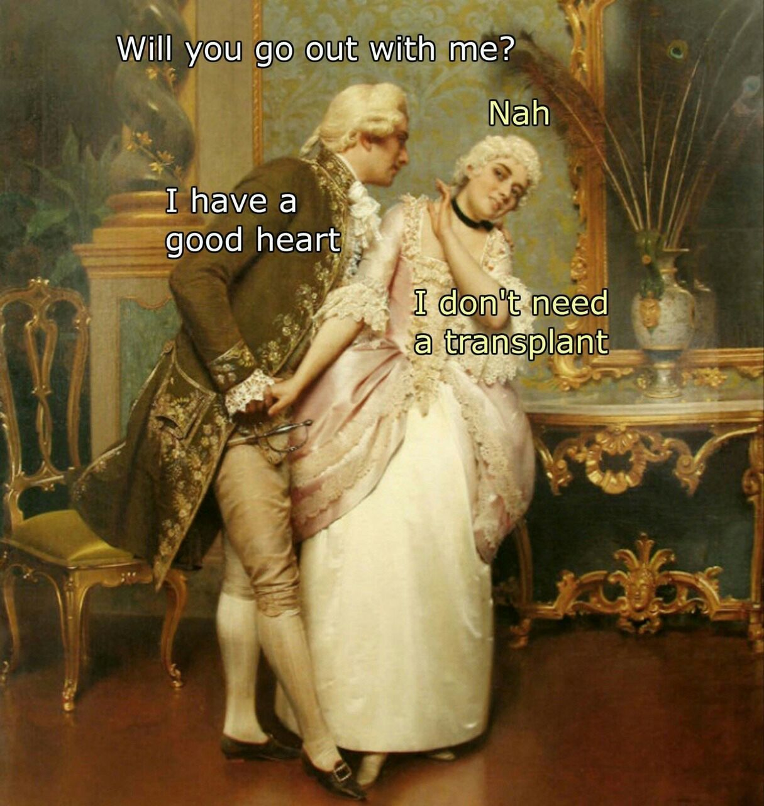
Cardiac Transplant Pearls
Denervation
Denervation of vagus → baseline tachycardia (100-110) / atropine ineffective
Ischemia presents as CHF, dysrhythmia, hypotension, syncope, arrest
Posterior right atrium with intact native sinus node → possibly two P waves on EKG
Beta adrenergic receptors are upregulated in the graft
Even without a pericardium, tamponade can occur due to scarring and adhesions (Do not perform blind pericardiocentesis)
Notes:
Scarring and adhesions can allow build up of pericardial fluid or blood
3000 procedures annually
5 year survival for adults and children is 72% and 80% respectively
Lifelong immunosuppression is required: most centers use three drug regimen (cyclosporine, prednisone, azathioprine
Pred and cyclosporine aggravates hyperlipidemia in many pts
Infection: most vulnerable period for infection is first 3 months when immunosuppression is maximal, in first month nosocomials predominate with usual gram negative and gram positive after first 3 months pts experience overall 20% per year infection, most common is zoster treated with high dose acyclovir. Nausea, vomiting, diarrhea should prompt search for CMV by culture and serologic testing
Any new HA with or without visual changes may be first symptom of meningitis or brain abscess and CT and LP should be done
All hearth transplant pts with fever should e aggressively evaluated unless a minor source of infection such as URI is obvious

Slide 23
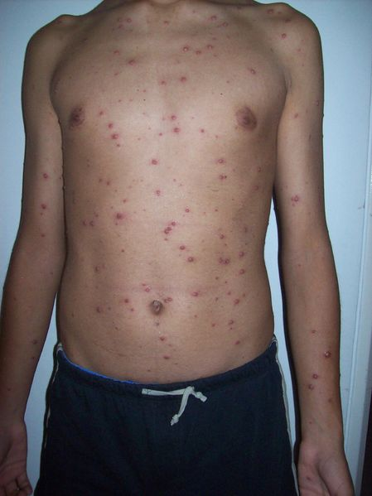
Bonus Question #3
A 6-year-old boy presents to your community ED in Colorado while on a skiing trip with his father with the rash to the right. While performing your HPI the father who is 44 casually mentions he had a cardiac transplant 3 years ago. After treating the boy what do you do?
Nice meeting ya’ll enjoy your ski trip
Recommend the father check in to receive the varicella vaccine and acyclovir
Recommend the father to check in to receive varicella immunoglobulin
Tell the father he needs to monitor for signs of infection and return for treatment if symptomatic
Notes:
https://wikem.org/wiki/File:Varicela_Rash.jpg
Pruiritic red macules spreading to extremities becomes vesicular on an erythematous base, lesions in various stages

Slide 24
Other cardiac notes….
Accelerated atherosclerosis caused by CMV, drug tox such as being on pred and cyclosporine
Rejection used to be more obvious now frequent biopsies are performed to monitor success of immunosuppressive therapy throughout patients' life…
Transplanted HR can increase with exercise or stress through exogenous catecholamines up to 70% max for age

Slide 25
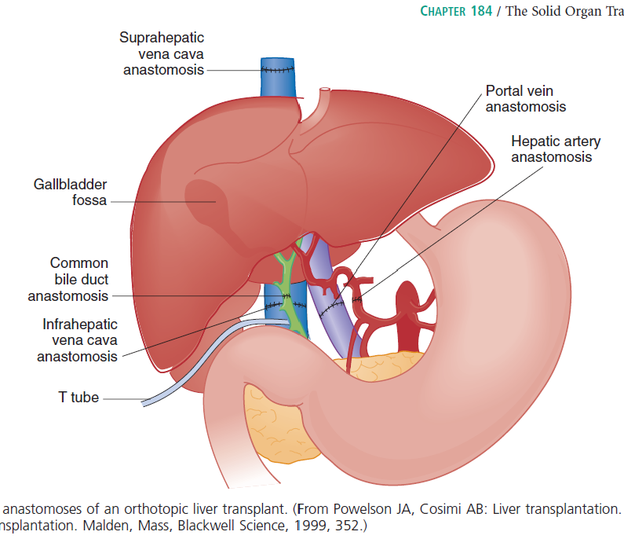
Liver Transplant Pearls
Survival: 1 year 86%, 3 years 76%
Anastomoses
Vessels first, hepatic artery stenosis most common vascular issue occurring early in course
Biliary system reconstructed, often stented with a T tube
Rejection
Is the norm
Commonly 1-2 weeks post op (fever, RUQ pain, elevated bili and transaminases)
Notes:
Typical liver transplant connectd to its host through 5 anastomoses: vessels first to allow reperfusion followed by biliary system reconsutruction often stented with a t tube to stop stenosis (in the early post transplant period t tubes may be replaced if stenosis develops)
Most common vascular complication is hepatic artery thrombosis often occurs early
Rejection: the norm, as soon as it is expected hospitalization and tx with high dose methylprednisolone should begin, if steroids fail OKT3 monoclonal antibodies are used in addition to polyclonal antilymphocyte globulin

Slide 26
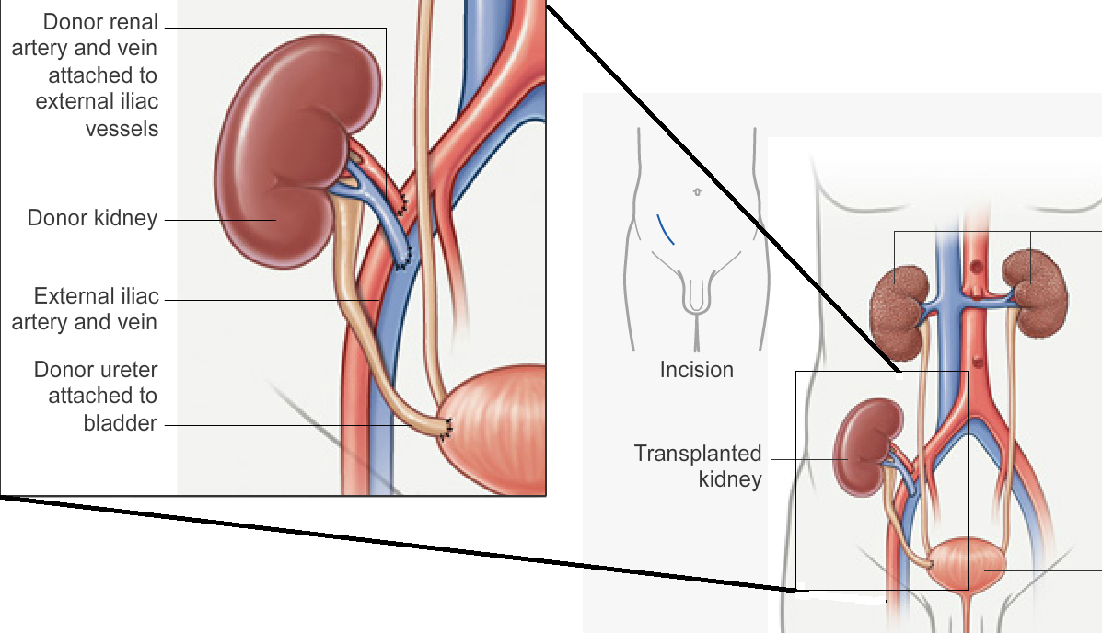
Renal Transplant
Survival: 1 year 96%, 3 years 91%
Infection
Pyelo in 45% of pts within 4 months
admit pts with pyelo
Rejection
Acute: lymphocyte driven
Chronic: Nephrosclerosis
Clinical: fever, swelling, tenderness, decreased UOP, increasing creatinine (even subtle increase)
Dx: color flow doppler
Notes:
Better long-term survival than dialysis! The most successful of the solid organ transplants
Early transplant rejection
US helps rule out obstruction, abscess, vascular thrombosis, perirenal collections of fluid, pus, blood, lymph
Kidney is typically moved into the retroperitoneal area of the anterior pelvis where is may be at risk from direst blows and seat belt injuries, risk if reported as being rare
Infection:
Pyelo in first month…increased risk of sepsis gram post oragnisms associated with wound infections and gram negative are predominant causes
Hep C is most common cause of hepatitis in renal traplsnt pts may be transferrd by blood transfusion or donoro organ because pretransplant ab testing is poor predictor of latent HCV
Rejection: see next slide, routinely long term immunosuppression with azathioprine, prednisone, cyclosporine needed

Slide 27
Renal transplant rejection path
Early: t lymphs against donor tissues including cytotoxic cd8 and cd4 cells. Laos b lymphs, NK cells, macrophages infiltrate foreign tissue. B cells make abs that impair perfusion
Chronic rejection: occurs after several years and result of nephrosclerosis. Proliferation of vascular intima of renal vessels → decrease in lumen size → systemic hypertension as graft fails from ischemia → tubular and glomerular atrophy

Slide 28
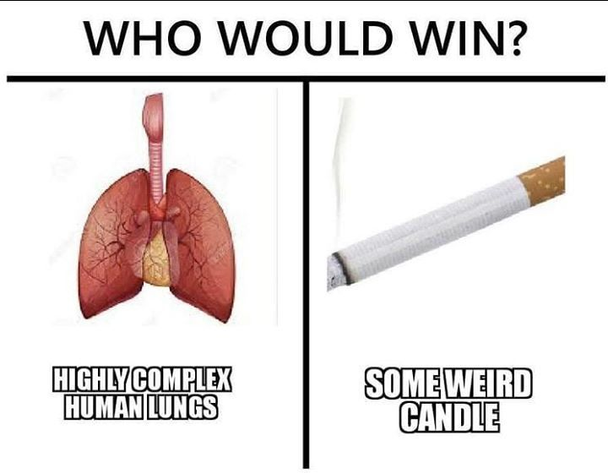
Lung Transplant
Survival: 1 year 76% alone, 56% with heart
Chest tubes more difficult, more adhesions
Rejection
Expected
Clinical: cough, dyspnea, fever, rales/rhonchi
When occurring over 1 mo 75% of CXR are normal/unchanged
Notes:
Data does show it benefits functional status, hemodynamics, quality of life. 800 annual in US
Usually unilateral except for cystic fibrosis
Pneumocystitis uncommon due to prophylaxis with Bactrim
There is no published experience with lung injury after transplantation comparison of cxr with preinjury studies is critical in trauma
Rejection: most pts have early rejection and 25-40% hace chronic rejection
Suspected acute rejection is treated with high dose methylprednisolone 500-1000mg/day, this reverses most cases
Infection: transplanted lung highly susceptive to pna bacuase they can be colonized by bacteria during ventilator stage of brain dead donor after transplant – diminished mucociliary clearance, decreased cough reflex due to decreased innervaion, and defective macrophages are present
Predominant bacteria are pseudomonase, staph aureus. Abx should be directed towards culture from tracheobronchial tree. PCP uncommoun due to routine Bactrim prophylaxis
Cmv is most common opportunisitic pulmo infection after lung transplant . Pts highest risk between 3 weeks and 4 months. It closely mimic rejecition. Tissue bx and rial cx required

Slide 29
Lung transplant additional
Acute rejection tx’ed wit high does methylprednisolone 500-1000mg/day.
Chronic leading cause of morbid/mortality. Path shows vascular sclerosis and limitation to airflow from obliterative bronchiolitis
Transplanted lungs with decreased mucocilliary clearance, decreased cough reflex, defective function of alveolar macrophages more susceptible to bacteria
Cmv infection resembles transplant rejectin
Candida colonization common, asperigillus also possible. They are invasive and can cause bronchiolitis obliterans syndrome by inflammation and obstruction of bronchioles

Slide 30
Pancreas Transplant
Singly or with kidney usually secondary to DM
1 year graft survival is 72%
Anatomical and Physiologic changes
Exocrine functions of the pancreas are drained into the bladder
Pancreas is placed in pelvis overlying iliacs = trauma concern
Bicarb is drained in urinary system = chronic non anion gap acidosis
Notes:
Exocrine functions of the pancreas are drained into the bladder = common GU complaints
- Duodenocystostomy fistulase may form early post transplatn]= abd pain, hyperamylasemia, leukocytosis, inc creatinine
You can ct scan with rectal contrast and iV and oral to better defin native and transplanted pelvic organs per rosens…

Slide 31
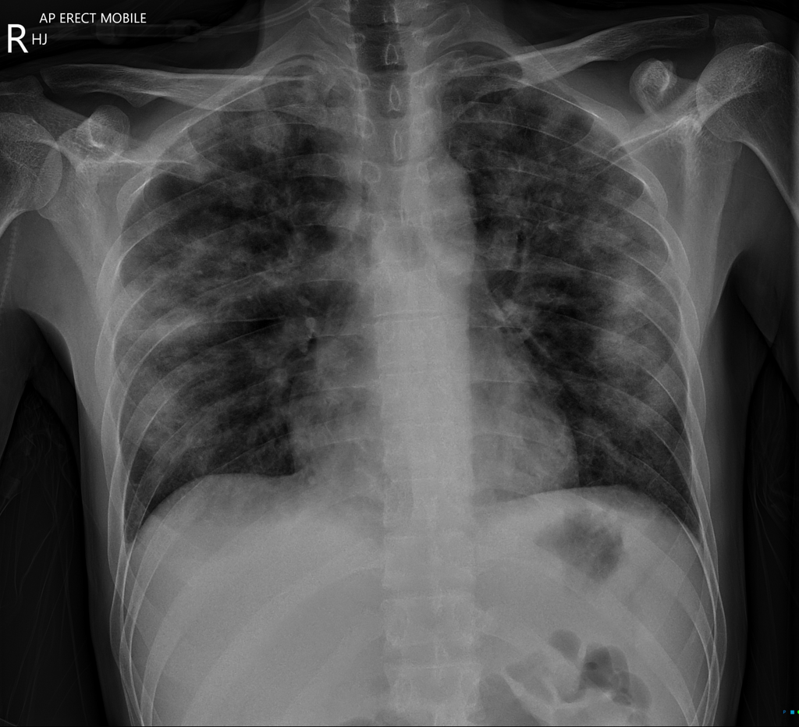
Bonus question #4
A 49 year old male with a history of renal transplant on immunosuppression presents to the emergency department with fever and cough. His symptoms have worsened over the past week and he is now short of breath at rest. His temperature is 102 F, BP 135/98, HR is 122, RR is 22, and oxygen saturation is 89% on room air. Which of the following medications will treat the most likely etiology of his symptoms?
Trimethoprim-Sulfamethoxazole
Rifampin, Isoniazid, Pyrazinamide, and ethambutol
Amphotericin
Vancomycin
Notes:
https://radiopaedia.org/cases/pnuemocystis-jerovecii-pneumonia?lang=us = image
Patchy bilateral peripheral alveolar consolidation

Slide 32
Summary
Differential diagnosis includes anatomical complications, rejection, infection, drug toxicity
Carefully consider drug interactions and toxicity
Clinical signs and symptoms of failure can subtle requiring careful and broad work-ups

Slide 33
Questions, comments?

Slide 34
References
Marx, John, Robert Hockberger, and Ron Walls. Rosen's Emergency Medicine-Concepts and Clinical Practice E-Book: 2-Volume Set. Elsevier Health Sciences, 2013.

