Slide 1
Fluid Status Evaluation
EM/CC LECTURE SERIES
LOGAN CALDWELL, DO
LT, MC, USN
NMCP EMERGENCY MEDICINE PGY 1

Slide 2
Fluid Management in Critical Illness is a Daily Challenge
Critical Illness characteristics can make optimizing fluid balance difficult
Hemodynamic instability
Leaky capillary beds
Multi-organ failure
Large volumes of IV fluids

Slide 3
Causes of Fluid Overload in the ICU
IVF Fluids
Initial fluid resuscitation and maintenance fluids administration
Acute Kidney Injury
Concomitant oliguria
Sepsis
Systemic inflammation, reduced oncotic pressure, increased capillary permeability
Congestive Heart Failure

Slide 5
From this to… The “Rivers” Protocol 2001
30 cc/kg in 1st 3 hrs

Slide 6
Fluid Overload in patients with severe sepsis and septic shock with early goal-directed therapy
Published in Shock, 2015
405 patients
24 hrs, 67% had evidence of fluid overload
72 hr, 48% had evidence of fluid overload
Fluid overload was associated with increased hospital mortality
OR 1.92
Notes:
Kelm DJ, Perrin JT, Cartin-Ceba R, Gajic O, Schenck L, Kennedy CC. Fluid overload in patients with severe sepsis and septic shock treated with early goal-directed therapy is associated with increased acute need for fluid-related medical interventions and hospital death. Shock. 2015 Jan;43(1):68-73.

Slide 7
CLASSIC: Liberal vs Restrictive Fluid Therapy in Septic Shock
June 2022, International RCT
1554 pts
In adult ICU patients with septic shock, IV fluid restriction did not result in fewer deaths at 90 days compared to standard IV fluid therapy. Restrictive 42.3% vs Standard 42.1%
Notes:
5 day cumulative fluid balance in the standard group was not much greater than the restrictive group.
Meyhoff TS, Hjortrup PB, Wetterslev J, Sivapalan P, Laake JH, Cronhjort M, Jakob SM, Cecconi M, Nalos M, Ostermann M, Malbrain M, Pettilä V, Møller MH, Kjær MN, Lange T, Overgaard-Steensen C, Brand BA, Winther-Olesen M, White JO, Quist L, Westergaard B, Jonsson AB, Hjortsø CJS, Meier N, Jensen TS, Engstrøm J, Nebrich L, Andersen-Ranberg NC, Jensen JV, Joseph NA, Poulsen LM, Herløv LS, Sølling CG, Pedersen SK, Knudsen KK, Straarup TS, Vang ML, Bundgaard H, Rasmussen BS, Aagaard SR, Hildebrandt T, Russell L, Bestle MH, Schønemann-Lund M, Brøchner AC, Elvander CF, Hoffmann SKL, Rasmussen ML, Martin YK, Friberg FF, Seter H, Aslam TN, Ådnøy S, Seidel P, Strand K, Johnstad B, Joelsson-Alm E, Christensen J, Ahlstedt C, Pfortmueller CA, Siegemund M, Greco M, Raděj J, Kříž M, Gould DW, Rowan KM, Mouncey PR, Perner A; CLASSIC Trial Group. Restriction of Intravenous Fluid in ICU Patients with Septic Shock. N Engl J Med. 2022 Jun 30;386(26):2459-2470.

Slide 8
CLOVERS: Early Restrictive or Liberal Fluid Management for Sepsis-Induced Hypotension
NEJM 2023, multicenter RCT, 1563 pts
Death before discharge home by day 90: 14.0% in restrictive group vs 14.9% in liberal group
Notes:
Possible selection bias,

Slide 9
The data is mixed and limited on fluid administration
Our goal as ICU doctors should be assessing each patient’s fluid responsiveness and asking ourself:
More fluid?
Diuresis?
Pressors?
This requires a multimodal approach

Slide 10
Evaluating Fluid Status
Noninvasive
Exam, I/Os, Body-weight, labs
Minimally invasive
POCUS
Bioreactance/NICOM
EtCO2, SPO2 wave form analysis
Invasive
CVP
PA cath (thermodilution CO/CI, PCWP/PAOP, SvO2)
A-Line (PPV, Pulse contour CO)

Slide 11
Clinical Evaluation of Fluid Status
Vital Signs
Mucus Membranes
JVD/Hepatojugular reflex
Edema
Skin turgor , cap refill
Chest auscultation – crackles
Body weight changes
I/O trends

Slide 12
Laboratory Evaluation of Fluid Status
CBC
LFTs
BUN/Cr
Lactate
BNP or NT-BNP
Urine (spec grav/osmolality, FeNa, Urine Na)

Slide 13
CXR Eval of Fluid Status
Pulmonary edema, pleural effusion

Slide 14
Clinical Exam, labs, and CXR are widely considered UNRELIABLE

Slide 15
Patient has edema in the legs but has signs of poor perfusion and you’re wondering if these could use some volume or diuresis So what’s the approach?

Slide 16
Fluid Responsive Definition AKA Where are they on the Frank-Starling Curve?
If given 500 cc of fluid rapidly, will SV increase by 10% or more?
Being fluid responsive does not mean fluid is indicated, only that CO will likely increase with volume
Fluid tolerance = absence of harm (pulmonary edema) when fluid is administered

Slide 17
Algorithm
We should also consider how our assessments affect the RV and LV
Can the RV take it?
IVC ultrasound
CVP
Can the LV use it?
CO monitors (NICOM, USCOM, PiCCO, EtCO2, Carotid and Brachial Artery Analyses, LVOT VTI

Slide 18
Types of Fluid Responsiveness (FR) Test:
Some tests MEASURE and predict FR in isolation
Some tests must be combined with a CHALLENGE maneuver
Tests can also be STATIC or DYNAMIC
Dynamic testing often perform better at predicting FR

Slide 19
Challenge: Passive Leg Raising
Positioning maneuver that returns ~300 mL of pooled venous blood to heart
Requires measurement tool of CO before/after
Very reliable challenge maneuver with low risk
If significantly volume depleted, potentially not enough “pooled blood” to challenge with
Not feasible to continuously perform throughout the day

Slide 20
Challenge: Fluid Challenges
500 cc crystalloid bolus
Ideally given with pressure bag, otherwise not quick enough for assessment
10-second mini/micro-fluid challenge
50-100 mL bolus over 60 seconds thru central line
Measure CO (PAC, A-line, NICOM) before and continuously throughout challenge
Changes in MAP and HR have very low SENS/SPEC for predicting fluid responsiveness
Mini-fluid Challenge of 100 ml of Crystalloid Predicts Fluid Responsiveness in the Operating Room | Anesthesiology | American Society of Anesthesiologists (asahq.org)

Slide 21
Challenge: High PEEP Challenge
Increase PEEP from 10 -> 20 ccH2O for 1 min while monitoring CO
CO decrease >10% suggests FR
Fluid responsiveness predicted by elevation of PEEP in patients with septic shock - WILKMAN - 2014 - Acta Anaesthesiologica Scandinavica - Wiley Online Library

Slide 22
Challenge: End Expiratory Occlusion (EEO)
Positive pressure ventilation increases intrathoracic pressure and decreases venous return/preload
Performing an end expiratory hold allows for a transient increase in preload and a 5% increase in CO suggest FR
Requires continuous CO measurement, increasing TV to >8mL/kg
Unreliable if spontaneously breathing or prone
The end-expiratory occlusion test: please, let me hold your breath! | Critical Care | Full Text (biomedcentral.com)

Slide 23
How do we assess our challenge maneuver– Need to measure Cardiac Output…
NICOM – Bioreactance
USCOM – Aortic Arch Ultrasound doppler
Pulse Contour Analysis (PCA) Alone
PiCCO – PCA + thermodilution
ETCO2 – PLR induced increase in EtCO2 >5% predicted fluid induced increase in CI >15%
Carotid and Brachial Artery Analyses
LVOT velocity time integral (VTI)
None of these really are very facile but could be considered if stuck…

Slide 24
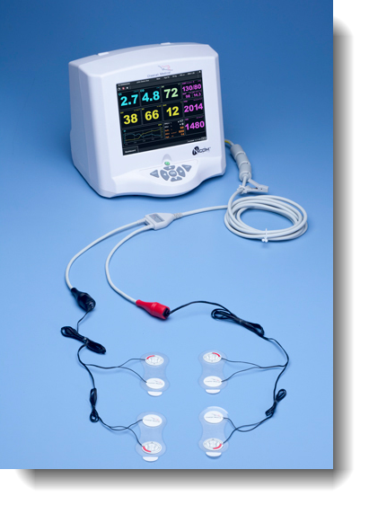
Measurement: NICOM
Requires challenge maneuver
Bio-reactance generates a external electrical filed to detect blood flow in the chest to yield CO/SV
>10% increase in SV suggests FR
Also appears reliable in prone patients
https://apm.amegroups.com/article/view/52330/html

Slide 25
Measurement: EtCO2
Requires CHALLENGE
Increasing CO allows for more CO2 delivery to heart/exhaled CO2
An increase of >5% in the EtCO2 level with PLR suggests FR
Performs well in the ventilated patient but unreliable in spontaneously breathing patients
https://pubmed.ncbi.nlm.nih.gov/27307176/

Slide 26
Measurement: Pulse Ox Waveform Analysis
Similar to PPV interpretation on A-line
15% respiratory variability in the pleth suggests FR
Limited studies, performs poorly
https://pubmed.ncbi.nlm.nih.gov/25727278/

Slide 27
Measurement (Dyanmic): Pulse Pressure Variation (PPV)
Requires A-Line
Variation of the pulse pressure during respiratory cycle
Lots of limitations: Need to be on ventilator with fixed tidal volume & without spont breaths, sinus rhythm, compliant lungs, no RV dysfunction, TV >6 mL/kg
>12% increase in PPV suggests FR
Only answers “Can the LV use it”
https://link.springer.com/article/10.1186/s13613-016-0216-7

Slide 28
Measurement (Dyanmic): Pulse Contour Cardiac Output
Requires A-Line
Waveform analysis can be used to estimate Stroke volume variation (SVV) or CO using proprietary formulas
Ex: FloTrac, LiDCO, PiCCO (transpulmonary thermodilution using a temperature sensing arterial line
Same limitations as PPV
Expensive
Only answers “Can the LV use it”
https://link.springer.com/article/10.1186/s13613-016-0216-7

Slide 29
What about the RV? Can it handle our fluid challenge?

Slide 30
Pulmonary Artery Catheter Pressures Thermodilution CO/CI
Continuous (heating) or intermittent (cold saline injection) via PAC
Requires Challenge
Interpretation: : 10-15% increase in CO/CI before/after PLR, bolus, EEO, or PEEP challenge
CCO PAC is gold standard in many studies
Limitations: catheter malposition, variation in injectate temp, shunt, respiratory effect, very low CO, or valvopathy

Slide 31
Pulmonary Artery Catheter Pressures PAOP/PCWP STATIC
PAOP/PCWP approximates LAP. Pts w/ low LAP may benefit from fluids
Interpretation: PCWP < 12
Limited data to support this. Again static variables are less reliable

Slide 32
Pulmonary Artery Catheter Pressures MIXED Venous O2 Sat (SvO2) DYNAMIC
An increase in SvO2 suggests improved CO, however high baseline SvO2 does not preclude FR
2% rise in SvO2 after fluid challenge, suggests FR. Unknown if ΔSvO2 useful w/ maneuvers
https://www.ncbi.nlm.nih.gov/pmc/articles/PMC3848814/

Slide 33
CVP STATIC
Requires central line
Low <8 mm Hg was associated with fluid responsiveness (specificity 76%)
Not great due to static variable , poor predictive value
More applicable if interpreted serially and for interpretation of “Can the RV handle it”
Lots of limitations: RV function & tricuspid valve function
Good assessing: Can the RV handle it?

Slide 34
Ultrasound Assessment IVC Size and Variation DYNAMIC
Tells you zero about the LV
Assists in answering the question “Can the RV handle it”
IVC size reflects RA pressure, similar to CVP
Measuring IVC size & phasic variation with respiration might predict FR
Distensibility is defined as the delta in IVC size with respiration
Interpretation: >15% distensibility is best threshold
Complete IVC collapse most sensitive for FR

Slide 35
Ultrasound Assessment LV End Diastolic Area (LVEDA) STATIC
Measure the cross-sectional area of the LV at the end of diastole (reflects adequate filling)
Requires M-mode measurement
“kissing papillary muscles” is the extreme
Poor evidence

Slide 36
Ultrasound Assessment LVOT VTI DYNAMIC
Measure outflow of blood from the LV
Requires Challenge
Variability in VTI is analogous to PPV, absolute values can be compared before/after a challenge maneuver
CO can also be calculated (with LVOT diameter & HR)
Interpretation: >15% increase in LVOT VTI predicts FR with good performance but technically difficult to perform
https://www.ncbi.nlm.nih.gov/pmc/articles/PMC7676570/

Slide 37
Ultrasound Assessment Carotid VTI DYNAMIC
Similar to LVOT VTI but easier to measure carotid facilitating repeat measurements
Requires challenge
Carotid flow time may also provide useful data
Patch based monitors may enable continuous monitoring.
https://www.bjanaesthesia.org.uk/article/S0007-0912(18)30233-2/fulltext
https://pubmed.ncbi.nlm.nih.gov/26410681/
https://journals.lww.com/ccejournal/fulltext/2020/01000/a_carotid_doppler_patch_accurately_tracks_stroke.7.aspx

Slide 38
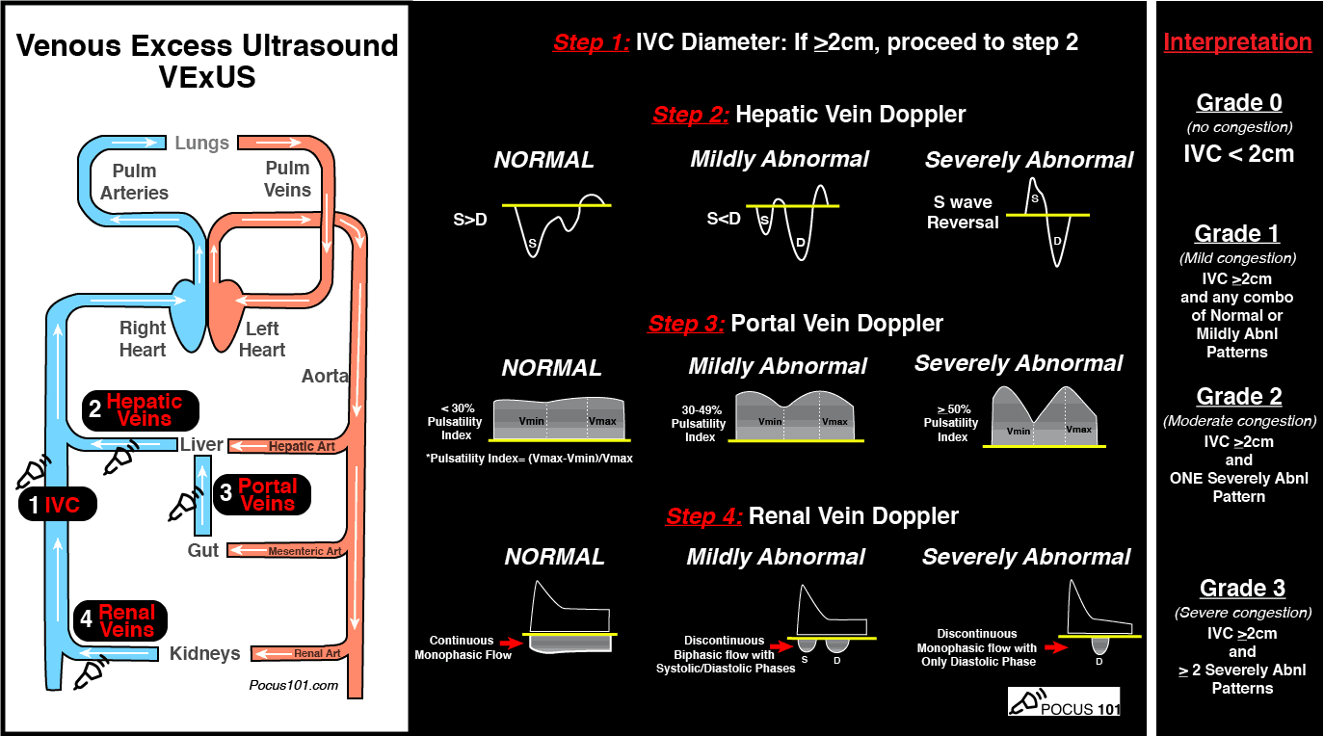
Ultrasound Assessment VeXUS Protocol
Multiple POCUS measurements
IVC Diameter
Hepatic Vein Doppler
Portal Vein Doppler
Renal Vein Doppler
https://www.ijccm.org/doi/pdf/10.5005/jp-journals-10071-23570

Slide 39
Other Ultrasound Assessments
Internal Jugular Vein >12.5 mm
Cardiac:
increased RV;LV ration
LV end-diastolic area >20cm
TAPSE
effusion
Lung:
confluent B lines (>3) in at least one lung zone
pleural effusion

Slide 41
Case: A 65-year-old woman presents with pneumonia. She is tachycardic (130-140 bpm) and hypotensive (SBP 80/40 mmHg) with an O2 sat of 88% on room air.
Administer a fluid bolus for insensible losses. 500 - 1000 ml of fluid is a good amount, but in a young patient with a good heart you can even go to 20 ml/kg.
After the initial fluid bolus, perform POCUS evaluating the heart, lungs, and IVC.
If the IVC is plump w/o respiratory variation, the CVP is already high and additional fluids are not useful. Added fluids may be harmful.
If lungs show prominent B-lines, there is already vascular congestion and additional fluids won’t be tolerated
If hyperdynamic heart and the LV is empty, additional fluids may be helpful
If LV squeeze is poor along with a plump IVC + B-lines, vasopressors are indicated

Slide 42
Final Thoughts
Clinging on to numbers can cloud our clinical judgement
Fluid responsiveness is dependent on both the LV & RV being preload dependent, NOT just the LV alone
Rule out obstruction to venous return (Can the RV handle volume?)
Look for LV failure (Can the LV use volume?)
Correct vascular tone

Slide 43
RESOURCES
EMRAP
EMCRIT
Pocket ICU
Rebel EM
LITFL

