Slide 1
GOALS OF CARE CONVERSATIONS & END OF LIFE CARE
EM/CC LECTURE SERIES
DOMINIQUE FERGUSON, DO
LT, MC, USN
NMCP EMERGENCY MEDICINE PGY3
SPECIAL THANKS TO:
LAUREN KALODNER, MD
LT, MC, USN
NMCP EMERGENCY MEDICINE STAFF

Slide 2
New Admission to your ICU
85 year-old Betty Lee, chief complaint: AMS
Vitals: BP 89/52, HR 98, RR 10, SpO2 85% on 6L NC, afebrile
Comes from Autumn Care, envelope at bedside, no advanced directive in chart
Notes:
You are working in the Chesapeake ICU when you are notified regarding a new admission to the ICU. 85-year-old female presents to ED via EMS with a complaint of altered mental status. She’s coming from an extended care facility, where she had not been acting like herself per facility staff. She has a stack of paperwork at bedside, and you notice the patient is altered and unable to provide any further history. You dig a little in the paperwork and note a history of dementia as well as a long list of other medical problems. Then you notice she has no known advanced directive, and see that her daughter lives out of state but is available via phone. Have you been here? Seen this patient?

Slide 3
OBJECTIVES
8 Step approach to leading a successful code conversation
The 4 C’s of Culturally Competent Care
Palliative Medicine & Hospice Care
Notes:
In medicine, sometimes you have these moments where you are like “yes I totally saved a life today” and other times you have these moments where you look up that patient who now has a trach and peg awaiting bed placement at an LTAC and pause to think if what you did is exactly what that patient would have wanted.
The presentation is designed to help you know what to do in these difficult situations, as well as to dive a little further into the understanding of palliative medicine.

Slide 4
Quality of life vs life extension
Notes:
Physicians are tasked with completing the hardest conversations in medicine – helping patients determine their goals-of-care and making rapid decisions regarding the use of life-sustaining therapies. We are responsible for setting the trajectory of hospitalization for seriously ill, many of whom arrive to the ED without advanced directives. The importance of this task has been amplified during the COVID-19 pandemic. More than 70% of older adults prefer quality of life rather than life extension. Furthermore, ≥ 60% of older adults consider “cannot get out of bed” or “rely on breathing machine to live” as equal to or “worse than death”[6].

Slide 5
Rapid Code Conversation Guide
Goal: Identify patients who prefer symptom/comfort-oriented treatments and consider the best possible outcome of mechanical ventilation/CPR “worse than death.”
Is this patient at high risk for poor outcome?
Serious illness
Frail elder
Patient resides in a nursing home or LTAC
Does the patient have a DNR/DNI?
YES: Confirm these choices
NO: Proceed to Code Status Conversation
Notes:
I want you to think of talking about code status with patients and families as a procedure with indications, contraindications, and even complications. This guide was developed based on best communication practices in the palliative medicine literature and refined by a panel of experts in serious illness communication and emergency medicine. It was further adapted by emergency physicians specifically for code status decision-making, and I have further modified it to fit in the ICU.
Focus the conversation on ascertaining the patient’s baseline function and desired outcome rather than wishes around a particular procedure (e.g., intubation). Through an organized series of steps and suggested phrases (outlined in the chart below), the rapid code status conversation guide allows physicians to succinctly obtain patient’s baseline function and outcomes that patient may consider acceptable for living in the time-pressured settings and make recommendations around intensive care focus on recovering from respiratory failure (i.e., intubation) or focused on patient comfort (i.e., no intubation).

Slide 6
Who to talk to?
Assess decision making capacity of your patient:
Understand the nature, extent, or probable consequences of health status and health care alternatives.
Make a rational evaluation of the burdens, risks, benefits, and alternatives of accepting or rejecting health care.
Communicate a decision.
Surrogate Hierarchy:
Health Care Agent named in an advance directive
Court Appointed Guardian
Next of Kin, 18+ years of age (in order: spouse, adult children, parents, siblings, grandchildren, grandparents
Person who has exhibited special care and knows the patient’s personal problems
Notes:
Ensure your patient has capacity to make decisions about life-sustaining treatments. If decision making capacity is in question, assess whether the patient can do ALL of these (see above). If not, discuss with their authorized surrogate.

Slide 7
Rapid Code Conversation Guide
STEPS | WHAT TO ASK
Ask what they know | Hello. I am Dr. ____. I am sorry to meet you this way. What have you heard about what has happened today to your [loved one]?
Break bad news | Warning shot: I am afraid I have serious news. Would it be OK if I share? Headline: Your [mother] is not breathing well from [pneumonia]. With her other health issues, I am worried she could become/is very sick and may even die.
Establish urgency, align | We need to work together quickly to make the best decisions for [her] care.
Baseline function | To decide which treatments might help your [mother] the most, I need to know more about her.
Patient’s Values (select appropriate questions) | Has she previously expressed wishes about the kinds of medical care she would or would not want? If time is short, what is most important to her? What abilities are so crucial to her that she would consider life not worth living if she lost them? Are there states she would consider worse than dying?
Summarize | What I heard is _____. Did I get that right?
Make recommendations | We will use all available medical treatments that we think will help your loved one recover from this illness. For her, this means care focused on ____. We will do ___ and not do ____.
Forecast | I hope these treatments will help your [mother]. We are still worried about how sick she is – our team will discuss with you how [your mother] is responding to treatment in the next 24-48 hours.
Notes:
1000 foot view, we are now going to break it down

Slide 8
STEP 1: Ask what they know
Hello. I am Dr. ____. I am sorry to meet you this way. What have you heard about what has happened today to your [loved one]?
Allow for expression of anxiety or fears, provide an emotional space.
Ensure understanding of condition and prognosis.
Notes:
By learning what they know it allows them to express their anxiety or fears. Also find out potentially valuable info that you can use in your conversation. Allow them to open up with whatever is filling up their mind. By giving the patient or family member an emotional space early in the conversation it will help you better understand where they are coming from and tailor you later questions and recommendations around his/her fear/anxiety. Allow for the diuresis of emotion because if later, information becomes higher, it will affect your ability to exchange information
Conversations have 2 effects: the first to share information and the second is an exchange of emotion. This point really aims to satisfy the latter.

Slide 9
STEP 2: Break bad news
Warning shot: I am afraid I have serious news. Would it be OK if I share?
Headline: Your [mother] is not breathing well from [pneumonia]. With her other health issues, I am worried she could become/is very sick and may even die.
Ask for permission to deliver bad news if they are unaware of what is happening.
Explain the bad news clearly, without medical jargon.
Allow space for emotion after you break the bad news.
Notes:
If the person Is not sad, angry, upset, stunned, you probably did not effectively communicate your bad news
If you get a medical question in response, respond directly to the emotion with something like “I cannot image how scared this must make you feel”. Avoid getting swamped in the medical details so you can have this convo about function and values

Slide 10
Step 3: Establish urgency, align
We need to work together quickly to make the best decisions for [her] care.
You and the surrogate need to remain on the same team.
Statements include:
“I’m really worried that we have to make a decision quickly.”
“I really want the best care for your _____.”
Notes:
If you and the patient or surrogate decision maker are not on the same page about wanting to help the patient, you will never get to a point of constructive decision making. So that you and the surrogate are working together to make this decision, there are a few statements you can use. You are putting yourself on the same side as them instead of putting yourself in a confrontational relationship with them where you are asking for something that they feel they have to resist to get the best care for their loved one.

Slide 11
STEP 4: Baseline function
To decide which treatments might help your [mother] the most, I need to know more about her.
Gather information, avoid phrasing “what is their baseline function”
“What type of activities was your mother doing day to day before this started?”
“Can you mother do ___ activity?”
“Has she been able to feed herself when given food?”
Notes:
You need to know what this patent can do at baseline so that you can predict what is going to be the best possible functional outcome for your patient. If you ask them “what is your mom’s baseline function?” no one is going to answer that helpfully, so you often have to ask probing questions. Is this a fully functional person who is walking around independently and driving a car or like a mild to moderate disability where he/she may need help going to the bathroom/feeding or does this patient already have severe dementia where there is already little to no function. So try “what type of activities was your mother doing day to day before this started”.

Slide 12
STEP 5: Patient’s values
Determine what quality of life the patient would find living for if he/she were to survive.
“They would want everything done” -> ask probing questions:
Has she previously expressed wishes about the kinds of medical care she would or would not want?
If time is short, what is most important to her?
How much would she be willing to go through for the possibility of more time?
What abilities are so crucial to her that she would consider life not worth living if she lost them?
Are there states she would consider worse than dying?
Notes:
This is the piece that is generally completely missing in most code status conversations. Investigate patient’s values and goals of care: tell me what matters to you as you think about your health and the future, tell me what you are hoping for with your medical care. Sometimes this is very clear. You ask something and get a very specific answer: “well my mom was already mostly wheelchair to bed bound and she already couldn’t smoke anymore because she was too tired to light a cigarette and she often said if I ever got any worse, I’d rather die.” But rarely to patients or surrogate decision makers offer that much information and Lots of times we just here “well she would want everything done” and you have to probe using the following questions. These questions are in series with 05 being the hardest. If you don’t get anything from the surrogate you need to ask progressively harder and more detailed questions. The questions are the tools and you can tailor them depending on how the patient/surrogate responds. Consider asking specific questions about intubation like “would your mother be ok if she was to become ventilator dependent.”
I want to be sure you get the care that helps achieve your goals. It’s helpful to know in advance whether you would or wouldn’t want certain medical treatments. For example, some people wouldn’t want a feeding tube or a machine that breathes for them, even it if might be temporary; other people would want those treatments. Sometimes those treatments have a good chance of working to keep a person alive, and sometimes they don’t. Have you thought about these kinds of medical treatments?

Slide 13
STEP 6: Summarize
What I heard is _____. Did I get that right?
“What I heard is your mother considered spending time with her grandchildren the most important but that she has been too weak to do that for a while and that she would consider treatments that would result in her not being able to get out of bed unacceptable.”
Did I get that right?
Notes:
Ask. Tell. Ask.
This helps the patient or the surrogate feel heard and again, is an alignment tool. This is KEY. Emphasizes to the patient/surrogate that you are on their team and allows you to reframe how things are going

Slide 14
STEP 7: Make recommendations
We will use all available medical treatments that we think will help your loved one recover from this illness. For her, this means care focused on ____. We will do ___ and not do ____.
Integrate what we have learned about functional status and values as well as patient’s prognosis.
“Based on what you have shared with me and what we know about this illness, I would recommend…”
Notes:
Again this is a critical step that is missing from our training in code convos. We are taught to offer “hey do you want A or do you want B” and “do you want intubation or do you want no intubation”.
Example: patient doing poorly at home. Multiple recent hospitalizations, increasing home O2 and decreased independence. What they fear most is not being able to return home after a hospitalization presenting in severe respiratory failure from COVID
‘Given how severe her COVID infection is and what I learned about her, I recommend focusing our treatment on assuring her comfort and avoid treatments that might not live the life she wants. For her this means intensive treatments to help treat her SOB and allow her to have a natural death without placing a breathing tube or using a ventilator.”

Slide 15
STEP 8: Forecast
I hope these treatments will help your [mother]. We are still worried about how sick she is – our team will discuss with you how [your mother] is responding to treatment in the next 24-48 hours.
Or, if the family is not ready to make decisions, set up a plan: “This topic deserves time and attention, let’s set up a time to talk again soon. Would you prefer for me to talk to someone else about this.”
Notes:
This is a time limited trial statement if that patient or surrogate does wish does pursue curative measures. This is a last attempt to align with the medical judgment of the surrogate or patient and a way that you can set our colleagues up for future success.
Thank you for taking the time to have this important conversation with me.

Slide 16
Rapid Code Conversation Guide
STEPS | WHAT TO ASK
Ask what they know | Hello. I am Dr. ____. I am sorry to meet you this way. What have you heard about what has happened today to your [loved one]?
Break bad news | Warning shot: I am afraid I have serious news. Would it be OK if I share? Headline: Your [mother] is not breathing well from [pneumonia]. With her other health issues, I am worried she could become/is very sick and may even die.
Establish urgency, align | We need to work together quickly to make the best decisions for [her] care.
Baseline function | To decide which treatments might help your [mother] the most, I need to know more about her.
Patient’s Values (select appropriate questions) | Has she previously expressed wishes about the kinds of medical care she would or would not want? If time is short, what is most important to her? What abilities are so crucial to her that she would consider life not worth living if she lost them? Are there states she would consider worse than dying?
Summarize | What I heard is _____. Did I get that right?
Make recommendations | We will use all available medical treatments that we think will help your loved one recover from this illness. For her, this means care focused on ____. We will do ___ and not do ____.
Forecast | I hope these treatments will help your [mother]. We are still worried about how sick she is – our team will discuss with you how [your mother] is responding to treatment in the next 24-48 hours.

Slide 17
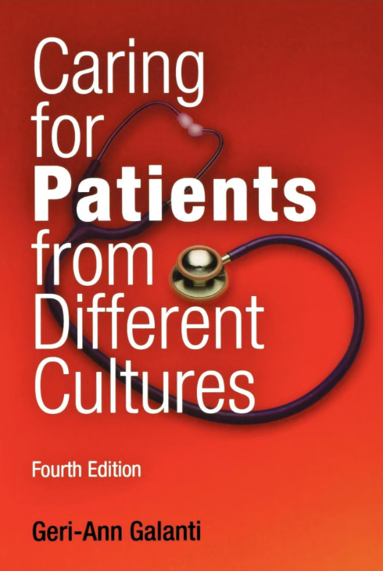
Culturally Competent Health Care
The 4 C’s of Caring for Patients from Different Cultures
Call | What do you call your problem? What do you think is wrong?
Cause | What do you think caused your problem?
Cope | How do you cope with your condition? What have you done to try to make it better? Who else have you been to for treatment?
Concerns | What concerns do you have regarding the condition? What potential complications do you fear? How does it interfere with your life, or your ability to function? What are your concerns regarding the recommended treatment?
Notes:
Call: Understand the patient’s perception of the problem.
Cause: This gets at the patient’s beliefs regarding the source of the problem. Treatment must be appropriate to the cause, or people will not perceive themselves as cured.
Concerns: It is important to understand the patient’s perception of the course of the illness and the fears they may have about it so you can address their concerns and correct any misconceptions. Also, it is important to know a patient’s concerns in order to avoid problems of nonadherence, because some patients may have misplaced concerns based upon their own or others’ past experience.
Example: Jorge Valdez, a middle-aged Latino patient, presented with poorly managed diabetes. When Dr. Alegra, his physician, told him he might have to start taking insulin, he became upset and kept repeating, “no insulin, no insulin.” Not until Dr. Alegra asked MR. Valdez what concerns he had about insulin did he tell her that both is mother and uncle had gone blind after starting insulin. He made the logical – though incorrect – assumption that insulin caused blindness. In this cause, the patient expressed his fears and because the physician was competent enough to pick up on them and explore them, she was able to allay them. In many cases, however, unless the physician specifically asks about concerns, patients will say nothing and simply not adhere to treatment. By asking, the provider can correct any misconceptions that can interfere with treatment.

Slide 18
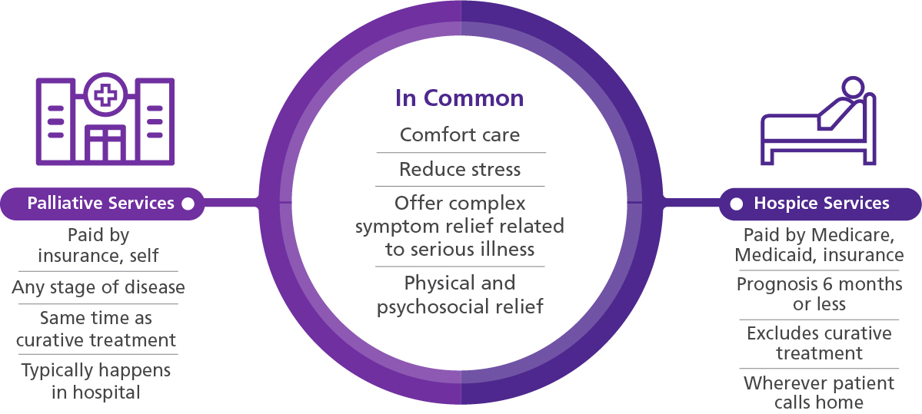
Palliative Medicine & Hospice Care
Notes:
Both palliative and hospice car are team-based, individualized medical care plus emotional, psychosocial, and spiritual care. This team typically is made up of professionals including, using hospice as the example, a physician, nurse, social worker, allied therapists, counselors, home health aides, spiritual and grief support and trained volunteers. While the objective of both hospice and palliative care is pain and symptom relief, the prognosis and goals of care tend to be different. Hospice is comfort care without curative intent; the patient no longer has curative options or has chosen not to pursue treatment because the side effects outweigh the benefits. Palliative care is comfort care with or without curative intent.

Slide 19
Resources
LT Kalodner’s “The Rapid Code Conversation” Presentation on 04 August 2021
EMCrit 276: The Rapid Code Status Conversation with Kei Ouchi
EM:RAP 2021 May Talking about Code Status
Rubin et al. “States Worse than Death Among Hospitalized patients”
JAMA IM, 2016; 176(10)
Grudzen et al. “EM Talk: communication skills training for EM patients with serious illness” BMJ, 2016; 6(2).
ALIEM.com
The rapid Code Status Conversation Guide
Serious Illness Conversation Guide (Block)
Shaida Talebreza MD, Jill Lowery PhD. EPERC Fast Facts, VITAL Talk, VA Goals of Care Conversation Training.
South West Hospice Palliative Care Network

