Slide 1
ACUTE LIVER FAILURE
EM/CC LECTURE SERIES
KIMBERLY PISTELL, DO
LT, MC, USN
NMCP EMERGENCY MEDICINE PGY4

Slide 2
OUTLINE
Definition
Causes
Workup
Labs
Imaging
Treatment
Summary

Slide 3
CASE
43 year old female presents for AMS and jaundice.
Vitals: HR 110, BP 95/72, RR 20, T 99.0, SPO2 98%
PMHx: HTN
Meds: amlodipine
SHx: none
Allergies: NKDA
Social: occasional EtOH
Exam findings
Confused
Jaundice
Diffuse abdominal tenderness without distension
Bilateral asterixis
Differentials?
Labs?

Slide 4
CASE
LABS
CBC normal
AST/ALT: 850/900
Scr: 1.8
Na: 125
Ammonia >400
EtOH: negative
Acetaminophen: negative
ASA: negative
Diagnosis?
Treatment?

Slide 5
ACUTE LIVER FAILURE: Definition
RAPID onset (< 12-26 weeks)
Impaired synthetic function (INR > 1.5)
Altered mental status (encephalopathy)
No prior history of liver disease (cirrhosis)
Acute, as opposed to chronic or acute-on-chronic, caries a poor prognosis with a high risk of cerebral edema and multiorgan dysfunction. Requires ICU care.

Slide 6
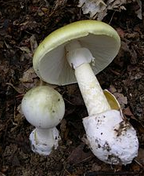
ACUTE LIVER FAILURE: Causes
Acetaminophen
Drugs
Toxins – mushrooms
Viral hepatitis
Ischemia
Autoimmune
Heat stroke
….
Acetaminophen is the most common cause in most developed countries.
Toxicity likely > 250 mg/kg or > 12g over 24 hours
Viral hepatitis most common cause in Asia and Africa
Amanita phalloides
“Death Cap”
https://en.wikipedia.org/wiki/Amanita_phalloides

Slide 7
ACUTE LIVER FAILURE: Workup
CBC
BMP
LFTs
Coags
Lactate
Ammonia
Tylenol level
HIV
Hepatitis panel
Autoimmune panel
ANA, anti-smooth muscle antibody
Right upper quadrant ultrasound

Slide 8
ACUTE LIVER FAILURE: Labs
Coagulopathy- INR > 1.5
Hyperbilirubinemia
Elevated transaminases
Hyperammonemia
Hypoglycemia
AKI
Hypo Na. K, Mg
Liver functions
Clotting factors
Conjugates bilirubin
Gluconeogenesis
Urea cycle- ammonia

Slide 9
ACUTE LIVER FAILURE: Labs
* Decreasing LFTS could be a sign of worsening liver failure
Corelate to INR & bilirubin
Rising = worsening
Coagulopathy- INR > 1.5
Hyperbilirubinemia
Elevated transaminases
Hyperammonemia
Hypoglycemia
AKI
Hypo Na. K, Mg
* AST/ALT/ALK P = injury
* Albumin, bilirubin, coags = function
Remember these patient are usually have a mixed hyper-hypo-coagulopathy

Slide 10
ACUTE LIVER FAILURE: Labs
LFTs > 3500 think
Acetaminophen
Ischemic injury
Coagulopathy- INR > 1.5
Hyperbilirubinemia
Elevated transaminases
Hyperammonemia
Hypoglycemia
AKI
Hypo Na. K, Mg
AST: present in liver, cardiac muscle, skeletal muscle, kidney, and brain.
ALT: primarily from liver (more specific)
- levels correlate with the degree of abdominal adiposity…

Slide 11
ACUTE LIVER FAILURE: Labs
Coagulopathy- INR > 1.5
Hyperbilirubinemia
Elevated transaminases
Hyperammonemia
Hypoglycemia
AKI
Hypo Na. K, Mg
* AKI seen in 30-70% depending on mechanism
→ Decreased ammonia clearance

Slide 12
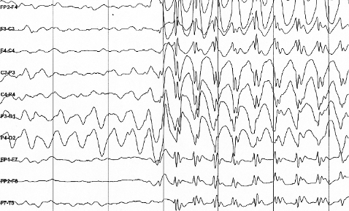
ACUTE LIVER FAILURE: Imaging
Ultrasound: look for portal HTN, cirrhosis, etc.
CT scan or MRI more sensitive for malignancies
EEG may reveal seizures when clinical signs absent
https://upload.wikimedia.org/wikipedia/commons/2/26/Spike-waves.png

Slide 13
ACUTE LIVER FAILURE: Hepatic Encephalopathy
Asterixis: seen in grade II-II, typically absent by grade IV
Cerebral edema: starts in grade III (25-35%)
Pupils: hyperresponsive (II-III) → slowly responsive (III-IV) → unresponsive
Seizures common
https://www.uptodate.com/contents/acute-liver-failure-in-adults-etiology-clinical-manifestations-and-diagnosis?search=acute%20liver%20failure&source=search_result&selectedTitle=1~150&usage_type=default&display_rank=1

Slide 14
ACUTE LIVER FAILURE: Treatment
Discontinue hepatotoxic drugs
Lactulose
Rifaximin
Hemodialysis
Sodium Benzoate
N-acetylcysteine
Steroids

Slide 15
ACUTE LIVER FAILURE: Treatment
Discontinue hepatotoxic drugs
Lactulose
Rifaximin
Hemodialysis
Sodium Benzoate
N-acetylcysteine
Steroids
Ammonia
All target reducing ammonia

Slide 16
ACUTE LIVER FAILURE: Treatment
muscle
Ammonia NH₃
Urea cycle
bowel
kidney

Slide 17
ACUTE LIVER FAILURE: Treatment
Lactulose impairs absorption
Decreases pH
Ammonia → ammonium which is not absorbed
Cathartic effect on GI tract further reduces ammonia absorption
Ammonia

Slide 18
ACUTE LIVER FAILURE: Treatment
Rifaximin reduces intestinal bacteria that produce ammonia
Ammonia

Slide 19
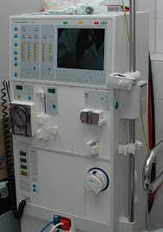
ACUTE LIVER FAILURE: Treatment
Hyperammonemia is an indication for dialysis – get nephrology on board early! - Rapid shifts can cause worsening cerebral edema
Continuous renal replacement (CRRT) is preferred over intermittent dialysis to avoid rapid electrolyte shifts which may cause fluctuations in intracranial pressure.

Slide 20
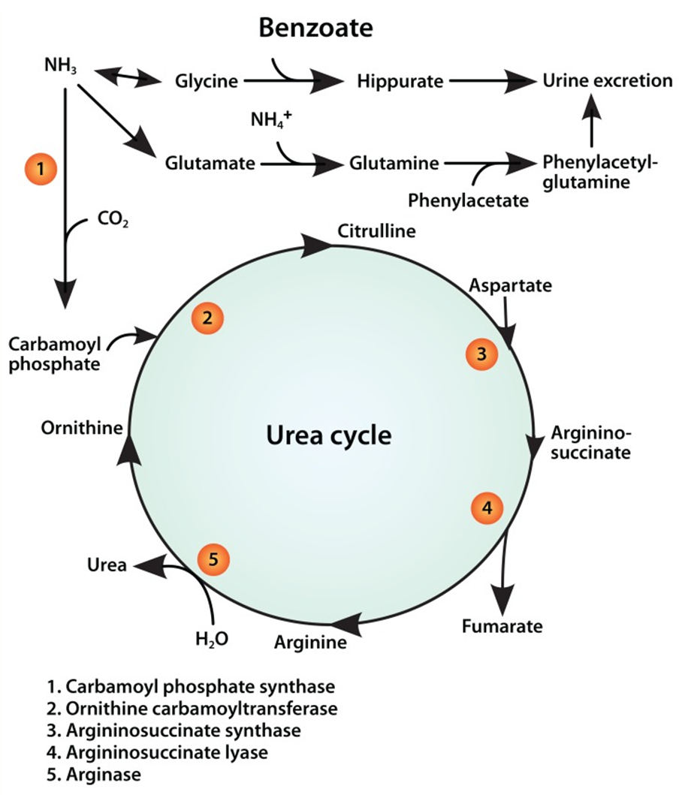
ACUTE LIVER FAILURE
Sodium Benzoate provides an alternative pathway for degradation of nitrogen waste
Hippurate is renally excreted or can be removed with dialysis
Misel ML, Gish RG, Patton H, Mendler M. Sodium benzoate for treatment of hepatic encephalopathy. Gastroenterol Hepatol (N Y). 2013 Apr;9(4):219-27. PMID: 24711766; PMCID: PMC3977640.

Slide 21
ACUTE LIVER FAILURE: Treatment
N-acetylcysteine
” …with non-acetaminophen-related acute liver failure, NAC significantly improves overall survival, post-transplant survival and transplant-free survival while decreasing the overall length of hospital stay.”
NAC helps neutralize free oxygen radicals
replenishes glutathione stores
source of sulfate-prevents hepatic damage
Walayat S, Shoaib H, Asghar M, Kim M, Dhillon S. Role of N-acetylcysteine in non-acetaminophen-related acute liver failure: an updated meta-analysis and systematic review. Ann Gastroenterol. 2021;34(2):235-240. doi: 10.20524/aog.2021.0571. Epub 2021 Jan 4. PMID: 33654365; PMCID: PMC7903568.

Slide 22
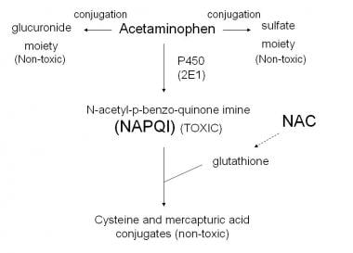
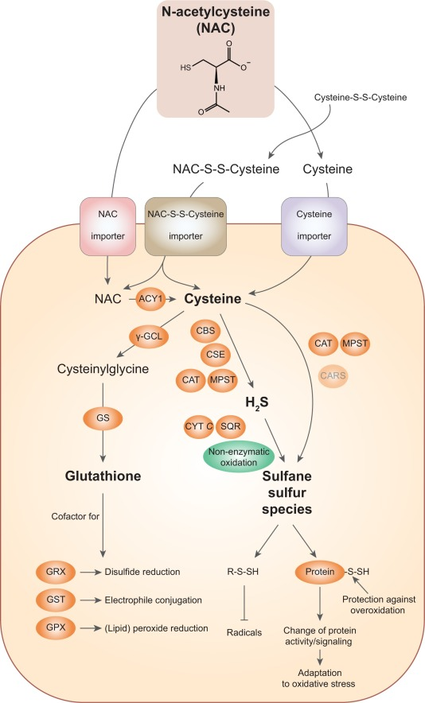
ACUTE LIVER FAILURE: Treatment
https://emedicine.medscape.com/article/820200-overview
https://www.sciencedirect.com/science/article/pii/S0163725821001182#f0040

Slide 23
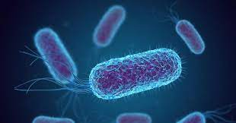
ACUTE LIVER FAILURE: Treatment
Steroids: Sometimes…Alcohol and autoimmune hepatitis
Antibiotics: Bacterial superinfection common.
- Have a low threshold to start

Slide 24
ACUTE LIVER FAILURE: Transplant
Consider if the patient may need a liver transplant and start coordinating care early → these patient deteriorate quickly!

Slide 25
ACUTE LIVER FAILURE
Livertox.nih.gov lists hepatotoxic medications

Slide 26
ACUTE LIVER FAILURE: Summary
Acute live failure is bad
Encephalopathy related to ammonia- start meds to reduce
Antibiotics, NAC, EEG, pressors
Get nephrology on board early for CRRT
Consider transfer to center capable of liver transplant

